Slide 1
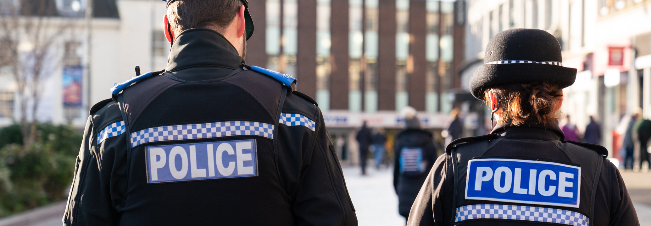
CONTACT
MANAGEMENT
Thames Valley Police Call Handling Overview
Thames Valley Police | Hampshire & Isle of Wight Constabulary
Notes:
Introduce yourselves, lead into Mikes Intro of why we got started:
Why were the PCCs interested – public moaning / police and crime plan
Why were the DCCs interested – HMIC inspection – low performance
What is the journey to start this initiative
Some tactical work in train but limited visibility on strategic change
Recently completed Digital Strategy re-draft – contact was a core pillar
Digital Public Contact strategy in its infancy
Why Mike / Simon narrative

Slide 2
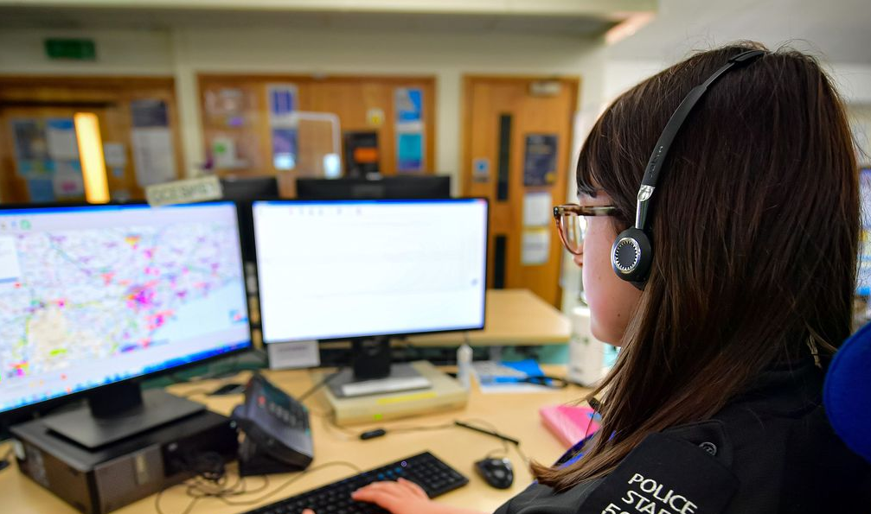
OUR VISION
CONTACT MANAGEMENT
“A modern, innovative and professional Contact Management department, that is accessible and able to effectively respond to those who need policing services.”

Slide 3
A STRATEGY TO
IMPROVE PUBLIC SERVICE
CONTACT MANAGEMENT
IMPROVE
ACCESSIBILITY
FOCUSED ON
PUBLIC SERVICE
DRIVE
EFFICIENCY
LOOK AFTER
OUR PEOPLE

Slide 4
Contact Management - Demand
CONTACT MANAGEMENT

Slide 5
999 Performance
CONTACT MANAGEMENT

Slide 6
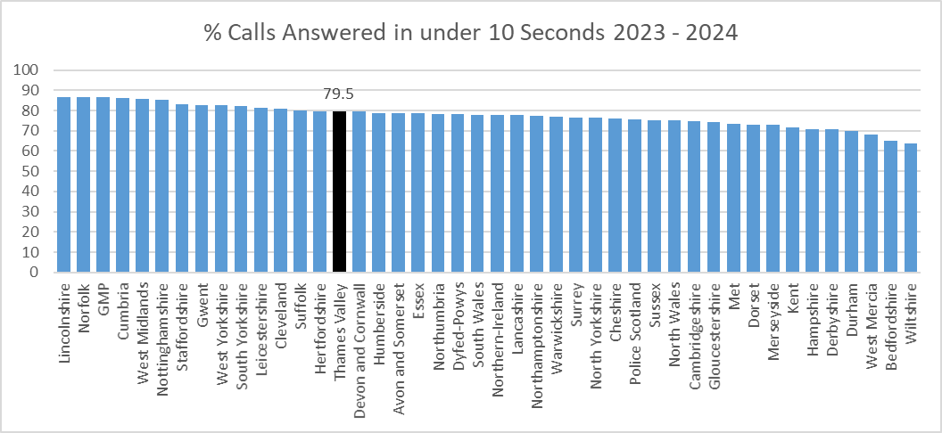
999 Performance (Cont.)
CONTACT MANAGEMENT

Slide 7
101 Performance
CONTACT MANAGEMENT

Slide 8
101 Performance (Cont.)
CONTACT MANAGEMENT

Slide 9
101 Performance (Cont.)
CONTACT MANAGEMENT
Above breakdown excludes calls to the VAD

Slide 10
Front Counters & Online
CONTACT MANAGEMENT

Slide 11
Improvement Strategy
CONTACT MANAGEMENT
People
Systems Stability
Demand Management

