Slide 1


Preventing Youth Violence:
Research & Evidence Conference 2025
Considering Procedural Justice

Slide 2
Re-considering procedural justice
Dr Paul Quinton

Slide 3
There is strong evidence for PJ, but…
What?
  Language
  Top-down
  Broad or narrow
How?
  A double-intervention
  Training
  Scripts
  Checklists
Who?
  Deserving and undeserving
Why?
  Group identity
When?
  Lop-sided impact of contact
  Frequency of contact
What else?
  Distributive justice
  Bounded authority

Slide 4
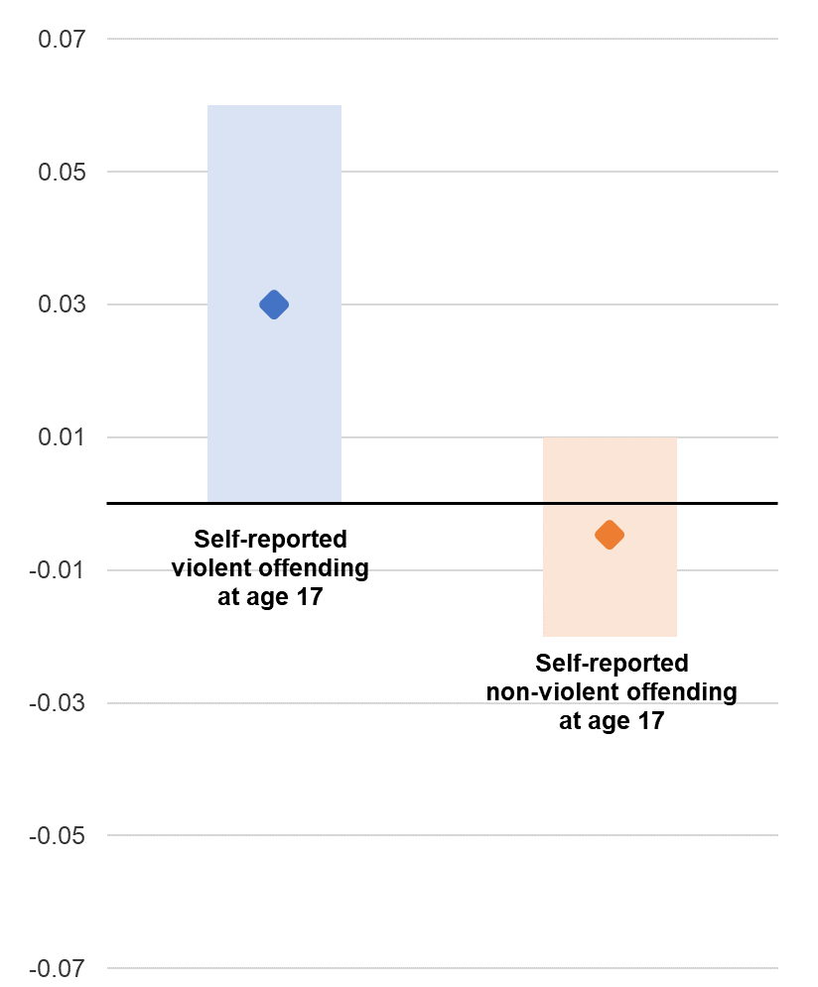
Unintended consequences
Analysis of the Millennium Cohort Study
Participants born in 2000
Followed-up every few years
Being stopped by the police at age 14 was associated at age 17 with:
  Increased violent offending
  Lower education performance
  Increased hyperactivity and conduct problems
Analysis controlled for prior offending, educational progress and mental health

Slide 5
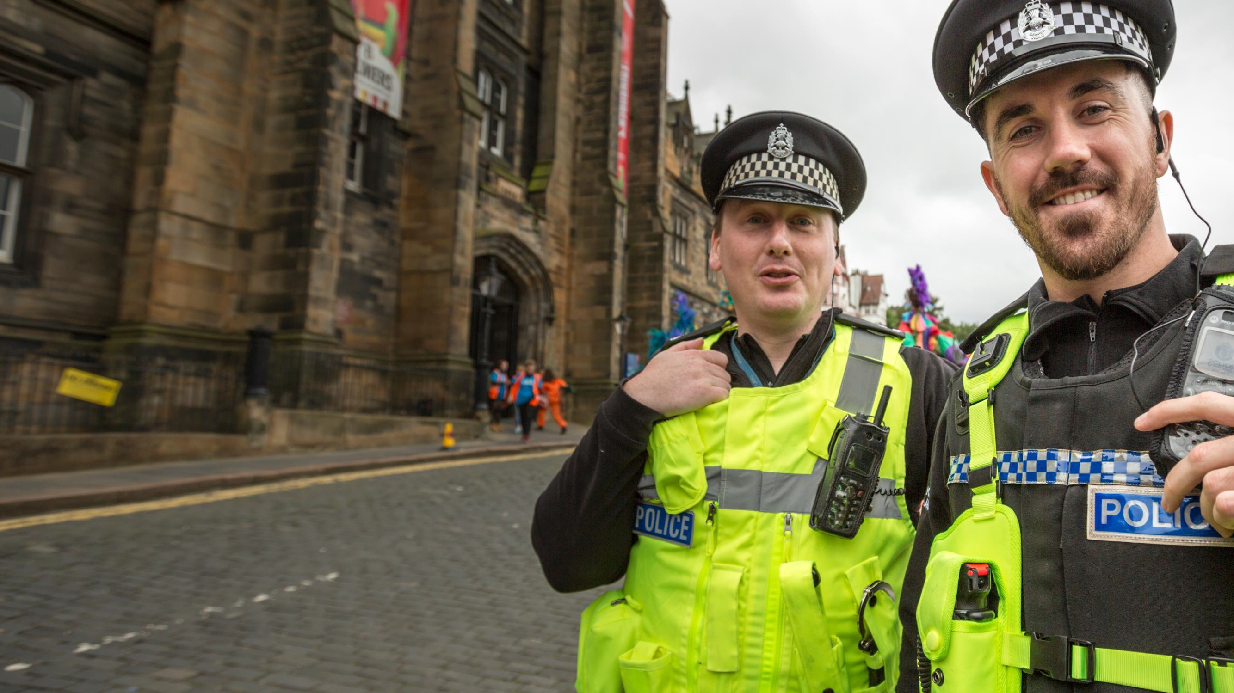



Embedding Procedural
Justice
Supt Simon Rotherham
NPPC Children & Young Persons portfolio

Slide 6
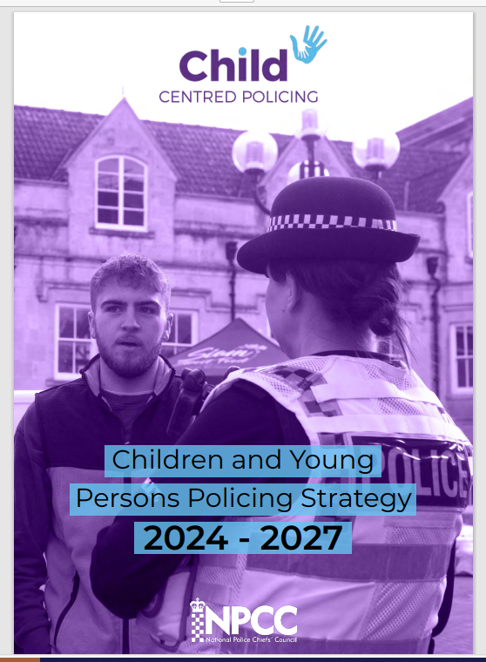
Children and Young Persons Policing Strategy 2024 - 2027

Slide 7
Our Vision
To create a culture of
Child Centred Policing
across the whole of policing in England & Wales

Slide 8
What Builds Legitimacy?
LEGITIMACY
Lawfulness
Effectiveness
Fairness
(PJ)
Bottoms, Anthony & Tankebe, J (2012). Beyond procedural justice: A dialogic approach to legitimacy in criminal justice. Journal of Criminal Law and Criminology, 102, 101-152
Notes:
Covid masks
Pension changes
Stop and search

Slide 9


FAIR
Is procedurally just, unbiased, inclusive and anti-racist.
It actively identifies disparity in the policing of children and young people across a range of often linked factors including care experience, poverty, race, gender, neurodiversity and will explain why disparity exists, or reform practice.
Is respectful, it hears the voice of the child by actively seeking out the views and wishes of all children, young people and their trusted adults.
It collaborates and empowers by providing choices and giving appropriate weight to those views and wishes when making decisions.
Ensures the voice of the child or young person is heard and considered in consultative, advisory and scrutiny processes.
Delivers trust and confidence by displaying to children and young people that policing is committed to making them safer and meeting their needs
You

Slide 10
£
Portfolio pillars
YourTrust delivers excellent Child Centred Policing that protects and reduces harm to build trust and conﬁdence.
YourVoice ensuring the voices of children and young people are heard throughout all of Policing
YourFuture ensures children and young people fulﬁl their potential in life by preventing victimisation, diverting offenders and supporting careers.

Slide 11
YourVoice
Capturing the voice of the child not only refers to what children say directly, but also to how they communicate through their actions.
It means seeing their experiences from their point of view.
We will actively seek out the views and wishes of all children, young people and their trusted adults.
In order to understand and properly serve children and young people, we need to hear from them, whether that is online or in person.
We need to be professionally curious and conscious of differing communication needs.
We will be informed by lived experiences.
We must ensure the Voice of Child is heard by both local and strategic police leaders and in our consultative, advisory and scrutiny processes
We will involve children and young people in decisions that impact them.
We know how important this is at an individual level but extends to issues that directly affect children and young people more generally.
Policing must show it has not simply listened, but has heard and responded by either taking tangible action or explaining why it has not.

Slide 12

£
CYP Charter 25
Call for evidence
change.yef@youthendowmentfund.org.uk.

Slide 13


Superintendent Caroline Hemingway
Gary Trowsdale

Slide 14

A broad-church approach to public health
"Our Children, not somebody else's problem"

Slide 15
WHO ARE WE?
▪︎ A membership cooperative made up of leading youth work orgs and VRU'S
▪︎ Originally launched as a legacy project to commemorate 20th anniversary Damilola Taylor tragedy in Peckham London
▪︎ Our mission was to create an interface between the entire UK Youth sector and national VRU network
▪︎ We stage hope Hack events across the UK creating safer spaces where young people share their views on what a fairer society could look like
▪︎ We have currently staged 37 Hope Hacks across the UK engaging almost 4,000 youth voices

Slide 16
OBJECTIVES
▪︎ To listen to what young people are asking for and to find solutions to acting on what's being said
▪︎ We believe entirely in public health philosophy and prevention infrastructures being key
▪︎ We believe in the VRU network and want to see it sustainably supported long term
▪︎ We feel civil society has a big role to play in safeguarding vulnerable young people and that there is a clue in the word public in public health

Slide 17
COMMUNICATIONS
▪︎ We all love the saying "It takes a village" but rarely interpret it correctly as if we do it's the perfect analogy of public health philosophy
Everyone in the village has a role to play its down to the village elders to connect up the dots "Our Children not somebody else's problem"
▪︎ If we are going to tackle issues that manifest out of poverty & inequalities then we need to be thinking about the infrastructures needed to tackle poverty itself. Far way too many children are living in poverty in the UK
It can't just be a cliché it needs to be a strategic goal. One that brings the Governments new Civil society Covenant into play.
▪︎ We cannot just say there is no Government money we need to create an environment that encourages private sector and philanthropic investment as well

Slide 18
WHATS NEXT?
▪︎ It's the 25th anniversary Damilola Taylor tragedy this December and by then we will have reached a total of 50 Hope Hacks
▪︎ We are constituting the Collective into a strong membership organisation. A movement of like-minded people dedicated to creating a fairer society for young people to grow up equally and safely in
▪︎ We believe violence is preventable but understand the challenges created by wealth disparity and are ready to rise to them

Slide 19
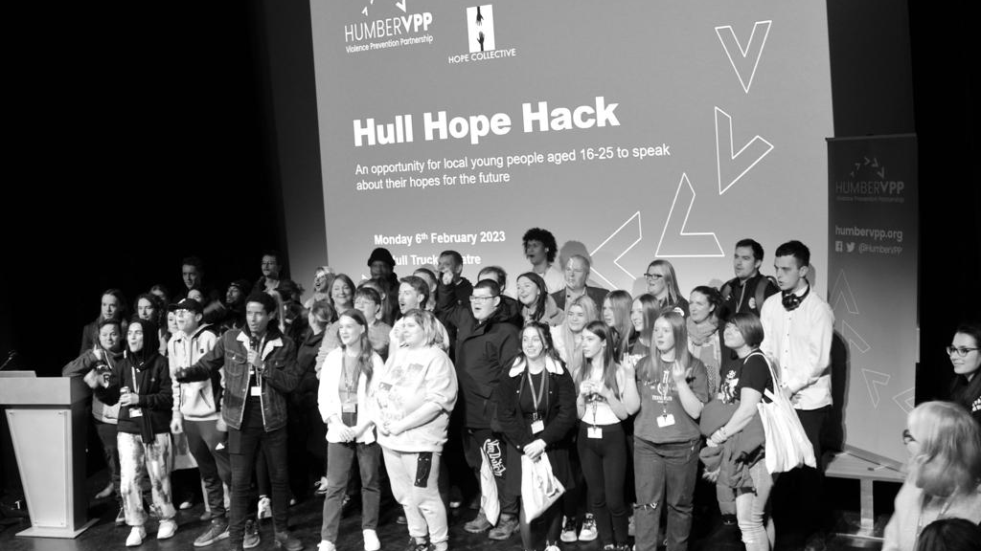
THANK YOU

Slide 20

Peer Action Collective in Yorkshire is delivered through EFL in the Community, Tigers Trust in the Community and Bradford City Community Foundation.
EFL in the Community is the charitable arm of the EFL (English Football League). EFL Football Clubs are based in the heart of 72 communities located all across the country;
Over 49 million people live within 15 miles of an EFL Club
1.1 million participants engaged in Club Community projects, and over £1.2bn in social value generated
Projects delivered by EFL Clubs and CCOs have helped to reduce the number of incidents of youth and adult crime resulting in cost savings of £4.24 million
EFL in the Community is the main advocate for all EFL Club Community Organisations.
Who are we?
Notes:
Point: We are representing PAC Yorkshire and Humberside. EFL in the Community works with Bradford City Community Foundation and Tigers Trust in the Community, the charitable arms of Bradford City FC and Hull City AFC. As part of PAC these two Club Community Organisations (CCOs) are delivering positive change within the community, that has been implemented by the 10 young people involved in PAC as peer researchers and social action leads. These young people are between the ages of 16 to 23, there are 6 male and 4 female, as well a range from minority ethnic backgrounds.

Slide 21




Addressing the barriers that prevent young people accessing positive activities, that can protect them from violence
Findings from our first Peer Action Collective research project.

Slide 22


77 research participants took part in interviews and focus-groups. In East and West Yorkshire.
The team diligently collected participant data who consented to take part in the project.
Qualitative data was collected through a series of one-on-one interviews and carefully moderated small focus groups. These interactions were recorded with participants' consent and subsequently transcribed to allow for detailed analysis and accurate interpretation of the data.
Methods of research and research participants
51% of participants were female, and 49% male.
38% of participants were under 16, 36% were aged 16-18, and 26% were aged 19-20.
44% of participants were White British, 31% were Asian/Asian British, 14% were Black/African/Caribbean/Black British, and 5% were from another ethnic group.
10% of young people interviewed were in care or had care experience.
23% of research participants had a health condition or disability.
31% of participants were from outside of urban areas.
Notes:
Overall, 77 research participants took part in interviews and focus-groups. To take part in the research young people had to be between the ages of 10 and 20 be at risk of being involved in violence (attending school or youth provision) in East and West Yorkshire.
Throughout the project, our team diligently collected participant data who consented to take part in the project. Qualitative data through a series of one-on-one interviews and carefully moderated focus groups, each consisting of no more than six participants to ensure meaningful and manageable discussions. These interactions were recorded with participants' consent and subsequently transcribed to allow for detailed analysis and accurate interpretation of the data.
Risk ad Ethics notes - To manage these risks, peer researchers and project leads undertook trauma-informed training and safeguarding training ahead of research. Weekly reflective practice sessions with the other peer researchers took place and had access to a member of staff to debrief with. At the end of interviews research participants were reminded of the safeguarding process, that they had the choice to withdraw from the research and how to do so. The Peer Research team also enegaged in weekly team meetings to discuss the research progress and the interviews, the peer researchers also took part in regular 1to1 catch ups with their project lead.

Slide 23
Key Findings that prevent young people accessing positive activities
For many of the young people we spoke to, not having enough money was a key barrier to getting to and engaging with positive activities.
A lot of young people told us that they didn’t feel safe & didn’t feel they had enough spaces where they felt safe and could be themselves
Many of the young people we spoke to felt under a lot of peer pressure and wanted more support from adults to better navigate this pressure.

Slide 24
A reoccurring theme was the rise in public transport fares, where vulnerable youth are disproportionately affected, limiting their ability to engage in activities that could provide positive development and social opportunities.
“[…]cost and travel, it needs to be easier because a lot of these things are in certain areas that don't have specific bus routes or you need to get two or three buses to get there, which makes people not want to go because they're spending most of the time travelling”. Female, 19.
Not having enough money
Notes:
Economic issues and wealth disparity are prevalent issues across Hull and Bradford, with charitable organisations in the city finding themselves with an ever-increasing workload. Undoubtedly, the cost-of-living crisis has contributed to a decrease in what is available for young people, as young people and their parents cannot afford the pressing expenses of extra-curricular activities.
A reoccurring theme was the rise in public transport fares, where vulnerable youth are disproportionately affected, limiting their ability to engage in activities that could provide positive development and social opportunities. “[…]cost and travel, it needs to be easier because a lot of these things are in certain areas that don't have specific bus routes or you need to get two or three buses to get there, which makes people not want to go because they're spending most of the time travelling”. Female, 19.
Transport companies -offer discounted travel passes for families whose children are recipients of free school meals. This will help young children to be able to attend Holiday and Food programmes during half terms. youth travel passes, especially during half terms and summer holiday periods. This will help young people be able to attend positive activities or positive opportunities such as employment.
Local Authorities to expand or start up youth employment and volunteering programmes. Advocate for the expansion of youth employment and apprenticeship programs in conjunction with local businesses and industries, to create more job opportunities tailored to the skills and interests of young people.
Education Establishments – Free after school activities. Enrichment led by young people. Helping to give them skills and experience for employment.

Slide 25
Many young people had significant safety concerns associated with; public transport, public spaces and venues for positive activities.
Some participants expressed their discomfort using the bus, citing frequent incidents of antisocial behaviour.
“[…] felt extremely uncomfortable at a bus stop […] a group of other young people hanging around […] often see fighting amongst young people” Male 17.
There was also a consensus that a lot of the activities are not accessible to young people due to location, and that this hasn’t been considered by organisations. With some young people stating those organising activities need to consider all young people when planning access, venues and routes to positive activities.
Improving Feelings of Safety
Notes:
There are also significant safety concerns associated with; public transport public spaces and venues for positive activities. Participant expressed their discomfort using the bus, citing frequent incidents of antisocial behaviour. Especially for young people traveling alone. In one of our interviews we had a participant express that they felt extremely uncomfortable at a bus stop if they saw a group of other young people hanging around a bus stop or platform where they needed to go. They went on to cite that they often see fighting amongst young people at bus or train stations.
There was also a consensus that a lot of the activities are not accessible to young people due to location, and that this hasn’t been considered by organisations. With one interviewee stating community groups need to consider all young people when planning access, venues and routes to positive activities.
The absence of well-lit streets, secure public transport options, and safe recreational areas further restricts their ability to engage in activities that promote their well-being. Many have voiced their fear of being out after dark, attending evening sessions, or waiting at bus stops.
Transport companies - Request transport companies to utilise youth voice in route mapping and improve the safety measures on board public transport.
Community Organisations – Those hosting positive activities should consult with young people during planning phases to ensure they are accessible, correct times and locations in order to meet the needs of young people and their feeling of safety and concerns of accessibility.

Slide 26
Knowledge of where to find positive role models that can protect young people from negative influences and people
“It's the way people are either brought up or like a lot of the time it's where people are brought up, especially around where I live. A lot of the troublesome kids and their parents are troublesome parents, and always cause bother”. Female, 19
“Just hanging about with the wrong crew […]. You might be doing that and you meet the wrong people because there’s, obviously, bad people, and you just meet the wrong people and you get in trouble, then you just go down the wrong path..” Male, 20.
Young people highlighted a range of important factors that positive activities can do in providing a trusted adult or positive role model, “If you go somewhere like a football club, you’ve always got someone, like your coach, that you can speak to.” Male, 14.
More collaboration and multi agency approach of local authorities, education and community groups.
Wider information sharing of what activities are available to young people and how to access them.
Young people need greater access to mentors, or help young people become mentors for others. Creating pathways for youth leaders and youth voice initiatives.
Wider education of the impact of negative role models and peer pressure in schools and from community organisations
Notes:
The relationship between, negative role models, peer pressure and youth violence is complex but crucial to understand. By creating positive alternatives and supportive environments, it may be possible to reduce the influence of negative peer dynamics and promote healthier behaviours and increase aspirations among young people. Young people highlighted the important factors that positive activities can do in providing a trusted adult or positive role model, “If you go somewhere like a football club, you’ve always got someone, like your coach, that you can speak to.” Male, 14.
More collaboration and multi agency approach of local authorities, education and community groups. Wider information sharing of what activities are available to young people and how to access them. Embed mentoring opportunities into so young people can access a mentor, or so young people can become mentors for others. Creating pathways for youth leaders and youth voice initiatives. Wider education of the impact of negative role models and peer pressure in schools and from community organisations.
Is there an opportunity for young people to co-develop a workshop about postive role models and the negative impacts of peer pressure to be delivered in Schools etc.

