Slide 1


Preventing Youth Violence:
Research & Evidence Conference 2025
Focused Deterrence

Slide 2


Another Chance Fund Focused Deterrence programme: a multicentred randomised controlled trial
Iain Brennan (University of Hull)
Tia Simanovic (University of Hull)
Paul McFarlane (UCL)
Will Graham (University of Abertay)
Alex Sutherland
ISRCTN: 11650008

Slide 3
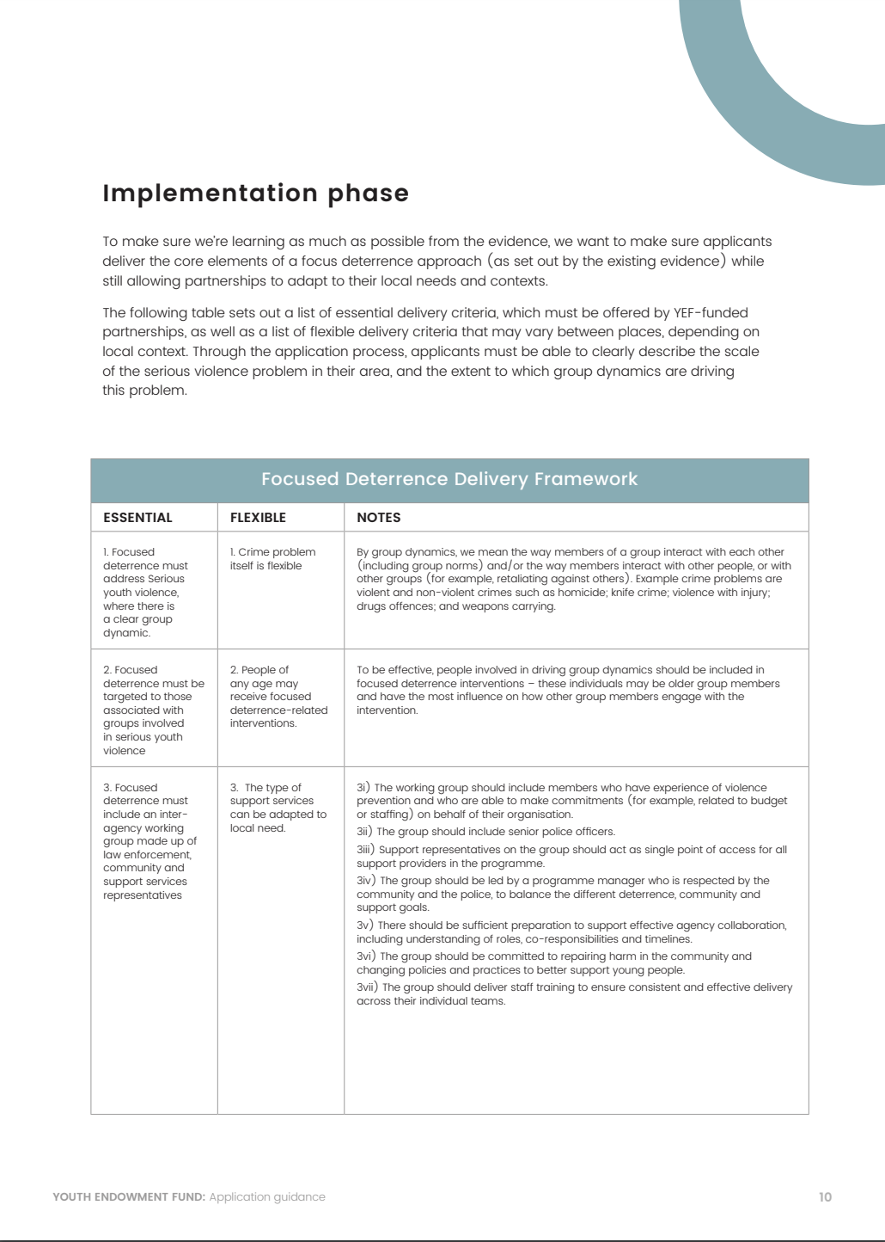
March 2022: co-alignment
June 2022: preparation
May 2023: early implementation
Jan 2024: full implementation
August 2025: follow-up period
August 2026: write-up
March 2027: early results
Notes:
Introduce ACF1 programme
Aims:
Preferences: Best quality evidence – RCT plus process evaluation

Slide 4
March 2022: co-alignment
June 2022: preparation
May 2023: early implementation
Jan 2024: full implementation
August 2025: follow-up period
August 2026: write-up
March 2027: early results
Notes:
Introduce ACF1 programme
Aims:
Preferences: Best quality evidence – RCT plus process evaluation

Slide 5
March 2022: co-alignment
June 2022: preparation
May 2023: early implementation
Jan 2024: full implementation
August 2025: follow-up period
August 2026: write-up
March 2027: early results
Notes:
Introduce ACF1 programme
Aims:
Preferences: Best quality evidence – RCT plus process evaluation

Slide 6
PICO
Population | 14 yrs + Police-recorded Group violence association
Intervention | Locally-developed, individually-targeted focused deterrence
Comparison | Two-armed stratified randomised controlled trial One year follow-up
Outcome | 1⁰ Number of violence against the person offences 2⁰ Number of co-offences 2⁰ Time to offence

Slide 7
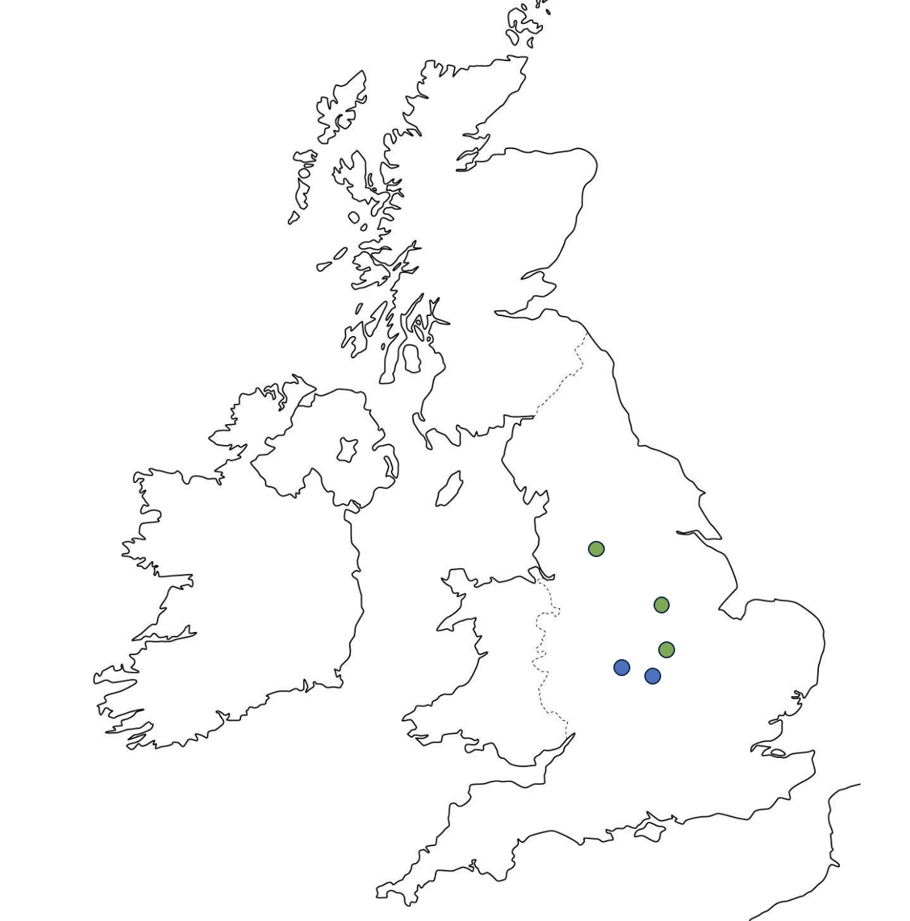

Slide 8
Statutory/OPCC-led
Lived experience navigators
Manchester
Nottingham
Leicester

Slide 9
Police-led
Wolverhampton
Coventry

Slide 10
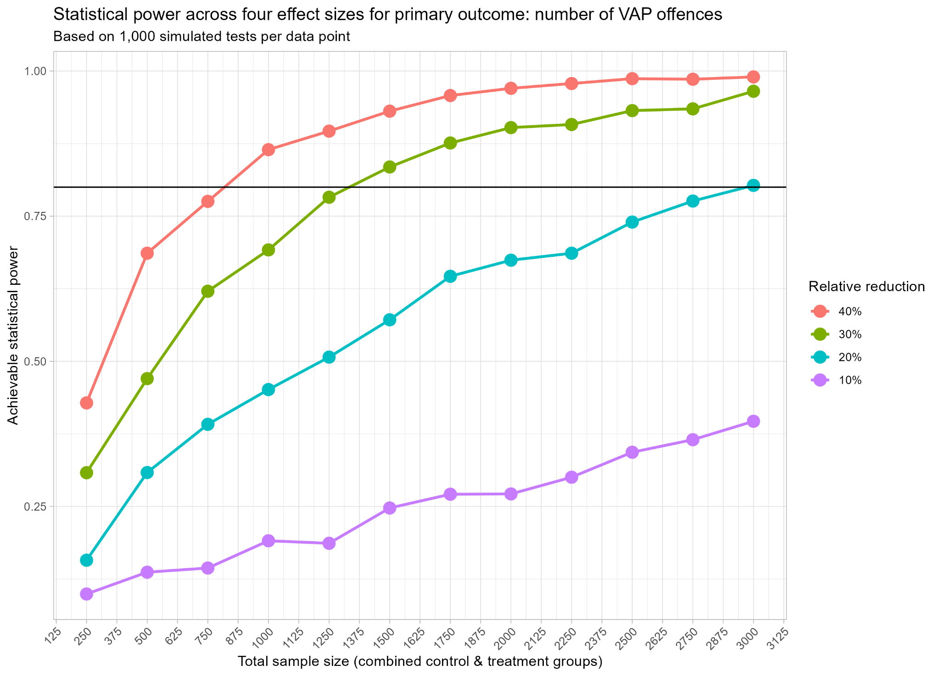
Notes:
Study design was big issue to overcome
Resistance to randomisation
Groups vs individuals

Slide 11
Context
Mechanism
Outcome
Police-led
Deterrence
Reduced violence
Statutory-voluntary (centralised)
Support
Needs met
Statutory-voluntary (decentralised)
Community
Community influence

Slide 12
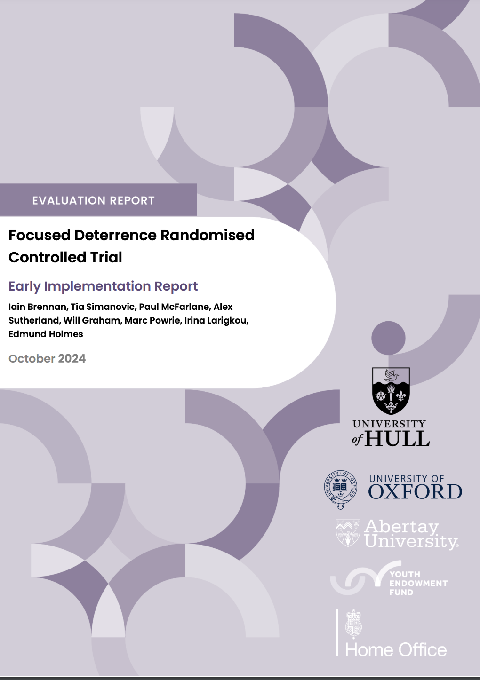
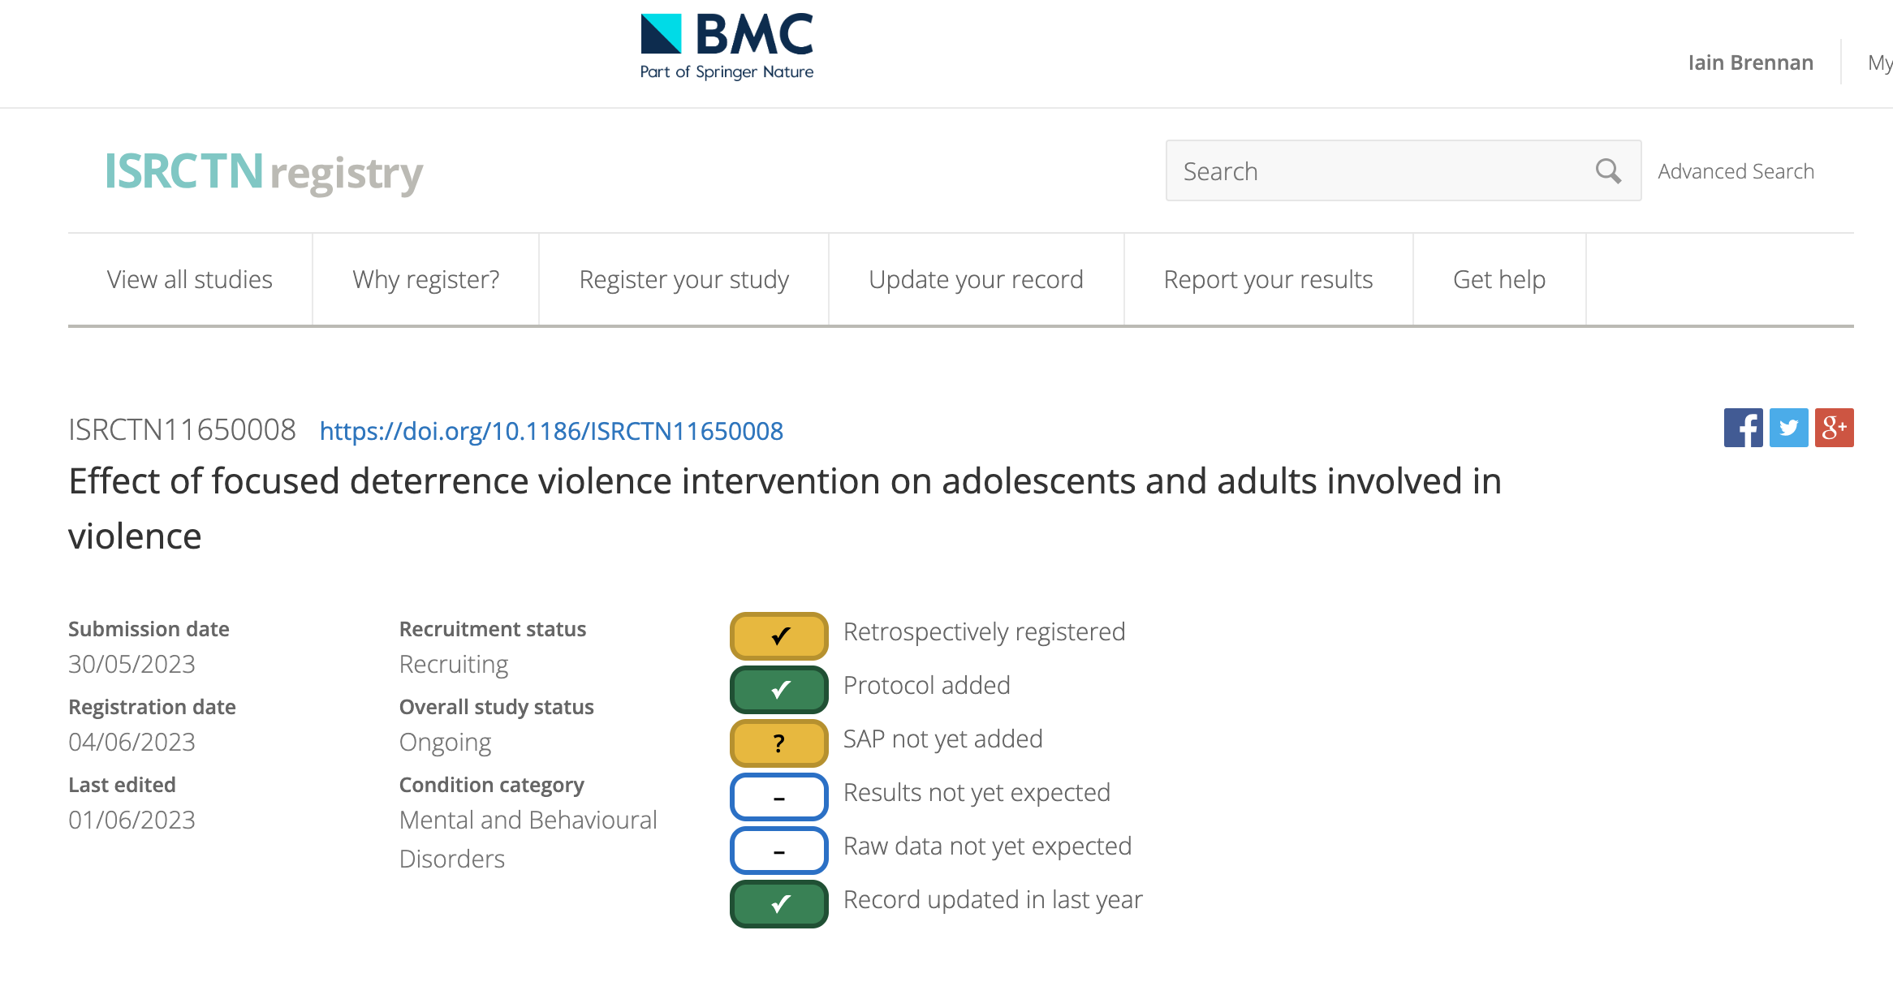
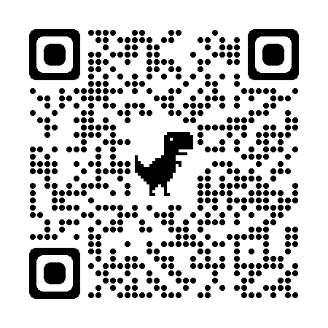
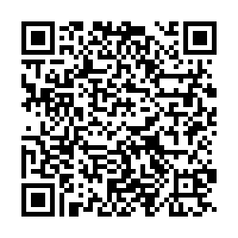

Slide 13
Focused Deterrence in Milton Keynes
Learning and Evaluation Network Conference
11th February 2025
Tori Olphin, M.B.E. – Head of Data Science, Research and Evaluation, Thames Valley Violence Prevention Partnership

Slide 14

Shared, Common and Costly Problem
Carrying and use of knives by children and young people in Milton Keynes affects all public services​
Focused deterrence was decided upon as a shared project to target habitual knife offenders
Randomised Controlled Trial
Young people (under 25) involved in repeat knife offending, or knife and violent or sexual offending

Slide 15
Shared, Common and Costly Problem
Carrying and use of knives by children and young people in Milton Keynes affects all public services​
Focused deterrence was decided upon as a shared project to target habitual knife offenders
Randomised Controlled Trial
Young people (under 25) involved in repeat knife offending, or knife and violent or sexual offending

Slide 16
Cohort Identification
Good data science is essential
Cohort both police and social services could agree on
Small budget, so impact needed to be maximised
Avoid expert selection
  Hard to ensure cohort will have high levels of reoffending
  Findings would be much easier to replicate or implement if based on data identified rules

Slide 17
Cohort Identification
Good data science is essential
Cohort both police and social services could agree on
Small budget, so impact needed to be maximised
Avoid expert selection
  Hard to ensure cohort will have high levels of reoffending
  Findings would be much easier to replicate or implement if based on data identified rules
Young people (11-25) who have had at least one knife offence as a suspect in the past 12 months and one of another knife offence, a violent offence, or a sexual offence as a suspect in the past 24 months
Either repeat knife offenders, or knife offenders who have also shown propensity to conduct violent or sexual offences

Slide 18
What is Focused Deterrence in Milton Keynes?
Social care led problem solving approach from a dedicated case worker
Procedurally-just police response to cases that fail to engage, or who continue to offend
In depth and intensive problem solving approach that lasts 12 months for each member of the cohort
  The young person gets a visit from social care explaining the process and what will happen (that they will receive tailored support from a dedicated care worker, but that the police will intervene rapidly if there is any sign of continued offending)
  Police officer visits to explain from the police side after this, to demonstrate involvement and attention, but also to show that they won’t be involved if the offending stops and the engagement with social care prevents their involvement in crime

Slide 19
What is Focused Deterrence in Milton Keynes?
Social care led problem solving approach from a dedicated case worker
Procedurally-just police response to cases that fail to engage, or who continue to offend
In depth and intensive problem solving approach that lasts 12 months for each member of the cohort
  The young person gets a visit from social care explaining the process and what will happen (that they will receive tailored support from a dedicated care worker, but that the police will intervene rapidly if there is any sign of continued offending)
  Police officer visits to explain from the police side after this, to demonstrate involvement and attention, but also to show that they won’t be involved if the offending stops and the engagement with social care prevents their involvement in crime

Slide 20
What is Focused Deterrence in Milton Keynes?
Social care led problem solving approach from a dedicated case worker
Procedurally-just police response to cases that fail to engage, or who continue to offend
In depth and intensive problem solving approach that lasts 12 months for each member of the cohort
  The young person gets a visit from social care explaining the process and what will happen (that they will receive tailored support from a dedicated care worker, but that the police will intervene rapidly if there is any sign of continued offending)
  Police officer visits to explain from the police side after this, to demonstrate involvement and attention, but also to show that they won’t be involved if the offending stops and the engagement with social care prevents their involvement in crime

Slide 21
What was delivered?
Eligible cases identified
Multi-agency care-led approach
Working out how to help, not taking the easy option
Person centred problem solving
  Trusted adult, allocated long term, who they could build a supportive relationship with
  The suite of options grew as the trial progressed
  In depth problem solving, done with the young person, not to them
Tracking at all stages
Randomised
Multiagency Panel
Business as Usual
Allocated to Case Worker
Case Worker Visit
Police Visit
In depth problem solving, with procedurally just policing

Slide 22

Results of the Trial after 12 months
A glossy ‘What Works’ report has been circulated, but please request it to be sent to you if you have not received it already. To reference, please use:
Olphin, T., Bottomley, S., Webb, A. & Stock, M. (2024) What Works Series: Focused Deterrence 12 Month Findings, Thames Valley Violence Prevention Partnership: Kidlington, UK

Slide 23
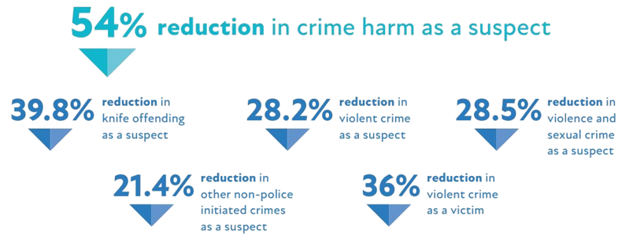
Overall experimental findings – all age groups
Statistically significant – less than 5% likelihood the finding was due to chance
Not statistically significant – more than 5% likelihood the finding was due to chance, but collectively they show positive results

Slide 24
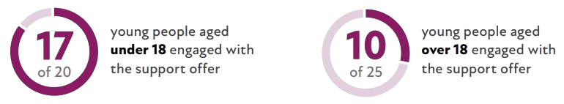
Engagement in Focused Deterrence
Delivery was much more difficult in over 18s
Sub-group analysis only conducted for under 18s due to level of engagement

Slide 25

Immediate Impact on Offending
Statistically significant – less than 5% likelihood the finding was due to chance

Slide 26
What does this mean?
Social care-led person-centred problem solving, conducted in a long term in-depth manner where a trusting relationship is built with the case worker, supported by a procedurally-just policing response, appears to reduce offending and victimisation in the most serious crime types by a large and significant amount

Slide 27
Implications for wider adoption and next steps
Small trial, so ideal implementation would involve either replication, or experimental implementation
Case workers need to remain able to conduct in-depth problem solving
  maximum caseload of 20-25 per case worker

Slide 28
Implications for wider adoption and next steps
Small trial, so ideal implementation would involve either replication, or experimental implementation
Case workers need to remain able to conduct in-depth problem solving
  maximum caseload of 20-25 per case worker

Slide 29
Implications for wider adoption and next steps
If implementing a version of this, findings are generalizable to:
  a person-centred problem solving approach
  based in children’s social care
  supported by a procedurally-just police response if there is continued offending
Likely less effective if implemented within policing, or within a voluntary or community sector partner as less easy access to data and additional services

Slide 30
Implications for wider adoption and next steps
If implementing a version of this, findings are generalizable to:
  a person-centred problem solving approach
  based in children’s social care
  supported by a procedurally-just police response if there is continued offending
Likely less effective if implemented within policing, or within a voluntary or community sector partner as less easy access to data and additional services

Slide 31
Police Testimonial
At the start of the intervention, a comment was made between policing colleagues that they did not think that many of the cohort would engage with the intervention as they were all offenders who were frequently on their briefings and were tough to work with. However, they went on to say that they were very surprised that the children and young people did engage. They noted that as time passed and the intervention was delivered these individuals stopped appearing on briefings; they just weren’t being suspected of the same crimes.

Slide 32


Stuart Nicholls (West Midlands Police, Partnering & Research Lead)
Antony Duff (West Midlands VRP, Criminal Justice Navigator

Slide 33

What is the Community Initiative to Reduce Violence
CIRV is a police-led Focused Deterrence that pairs young people with a navigator to support or disrupt people to disengage from violent groups and violent behaviour.
The objective of CIRV is to identify and then help manage the root causes of violence through genuine trust-based relationships, but with clear consequences communicated and delivered if engagement is not forthcoming.
CIRV identifies risk, is able to be there at reachable moments, sequences interventions that are more often than not already commissioned, and places young people into opportunities.

Slide 34
The Eligibility Criteria
Aged 14+
Links to group based violence.
Must live in Coventry or Wolverhampton, or within an hour if placed out of city.

Slide 35
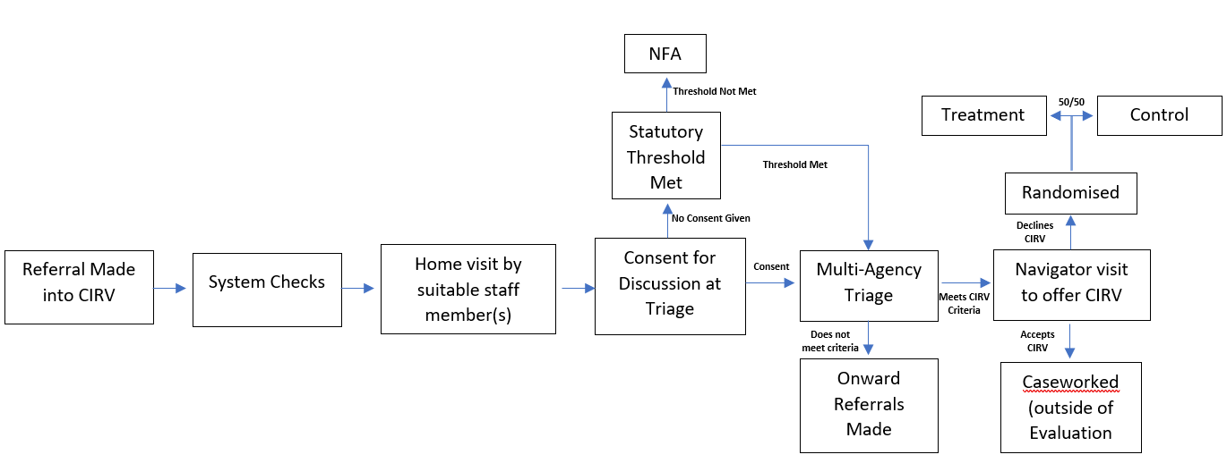
Selection & Triage Process

Slide 36
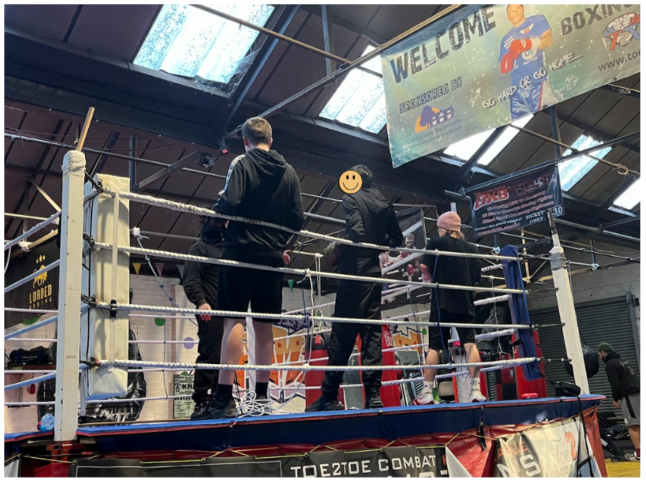
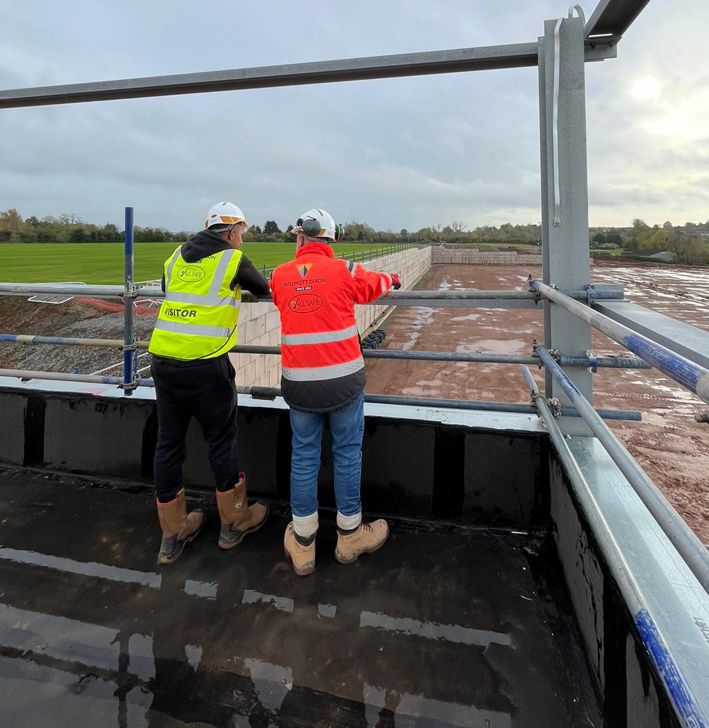
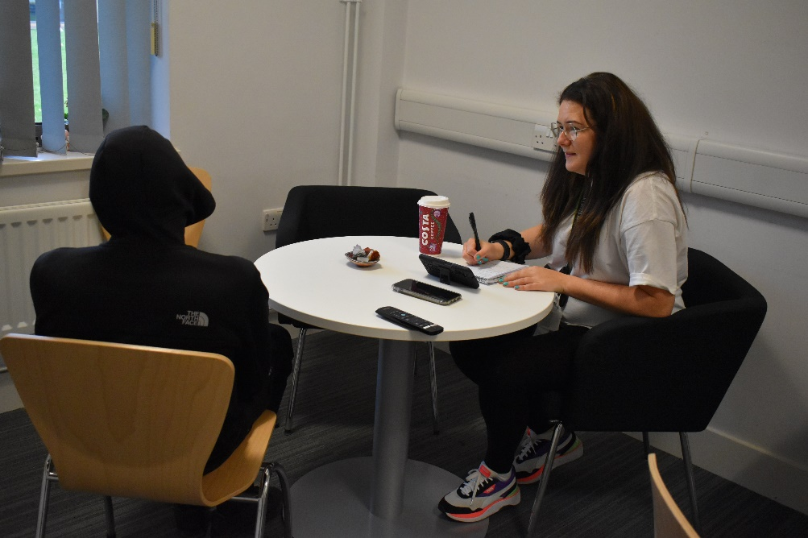

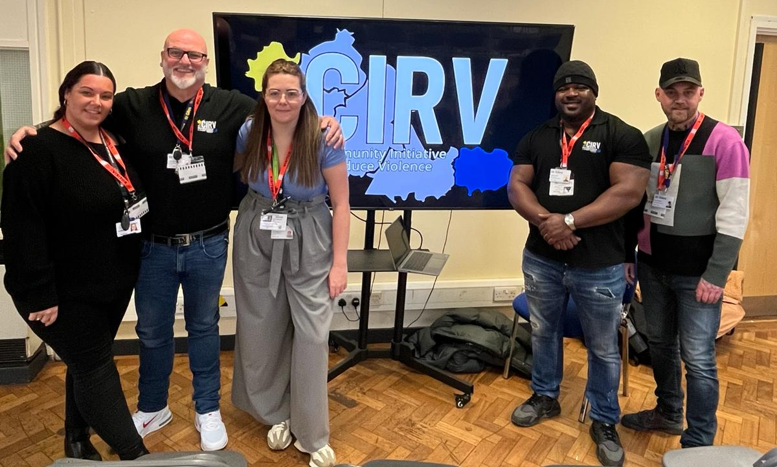
The Support Offer
St Giles Mentor
A-Vision Counsellors
Family Support Workers
Education & Employment Support
St Giles Volunteers
Wider Local Offer
Local Sports offers
Focused on their interests and goals
1-2-1 support to understand the root causes
Festive hampers for families in need
In-house lived experience mentoring

Slide 37
Disruption Activity
Phase 1
Disruption team conduct a visit, speak to individual and parents/carers
Phase 2 – non engagement
Tactical disruption options bespoke to the individual provided to PCT and other relevant officers
Phase 3 – non engagement
Warrant enforcement where applicable
Individual provided with offer of support via letter (handed to them) for further details.
Individual PMP updated with the outcome of the visit
Results emailed to CIRV supervision
Officers update PMP
Officers monitor connect for new intelligence. This includes gathering information for PIR – seek for disruption opportunities
Officers pro-actively police Individuals
Partnership working with other forces

Slide 38
What Success Looks Like
Every 6 weeks, a STAR assessment will be carried out collaboratively with the cohort member.
When their needs are met, a bespoke exit plan is co-designed which can include funded education placements, a volunteer mentor, work placements where suitable, and ongoing support from partners.
Sustainable progress is made which results in no further offences.
If they require CIRV support again, they are welcomed back on the programme.

Slide 39


Information in policing systems
50% of the cohort have a ‘significant’ policing footprint
  having been the suspect in multiple offences (or a very serious offence) and have a strong intelligence footprint.
61% are only known to WMP, however…
28% are known to 2-3 other forces, and;
11% have come into contact with 4 or more different forces (excl. BTP).

Slide 40

Accepting the CIRV offer
Of those who did or did not accept the CIRV offer;
U18’s are slightly more likely to accept than those aged 18 and over.
IC1 individuals are fractionally more likely to accept than IC3 and IC4 – but not to an extent that is of statistical significance.
There is very little difference in acceptance levels across different socio-demographic groups.
Notes:
Coventry 9% black at census
Coventry 66% white
Coventry 19% Asian
Wolverhampton 9% black
Wolverhampton 61% white
Wolverhampton 21% asian

Slide 41
Accepting the programme
Those who were only known to WMP are more likely to accept CIRV than those with offending or intelligence across multiple force areas.
Individuals with no offences in the 12 months prior to referral were slightly more likely to accept CIRV.
Those with more significant longer-term policing footprints were no more or less likely to accept than those with more limited or minor offending/intelligence histories. The recency of (suspected) offending was a much more important factor.
Notes:
It may be the case that those whose activity is more rooted in their local area, and who have not lived elsewhere, are more likely to want a pathway out of offending through CIRV.

Slide 42
Current summary
Under 18s more likely to accept the CIRV offer.
Those only known to West Midlands Police more likely to accept offer.
Those with no offences in 12 months ahead of referral more likely to accept offer AND complete with their needs met.
Those with ‘significant’ police recording no more or less likely to accept CIRV offer – but take much longer to complete with needs met, and slightly more likely to disengage.
  especially if they were linked to offences within last 12 months
Notes:
NB: This is an initial summary – and will change as the evaluation progresses.

