Slide 1


Slide 2
Introduction

Slide 3
Reflections on shared challenges and lessons learned; and a vision for public sector research
Learning and Evaluation Network Conference – 11th February 2025
Tori Olphin, M.B.E. – Head of Data Science, Research and Evaluation, Thames Valley Violence Prevention Partnership & Director of Research, ResearchCore

Slide 4
Debunked Some Myths:
Experimentation and Research
Big
Complicated
Or
Difficult
Expensive
Take ages to run
Just any implementation with an evaluation afterwards
Not something we can do

Slide 5

Fundamentals are key
Data Science
Planning
Research
It is Cohort Agnostic

Slide 6
4 RIGHTS

Slide 7



Right Person
Identified
Correctly
Incorrectly
£
Not Identified

Slide 8
Right Intervention
Resources
Attention
FINITE
Space
Time
Money

Slide 9
Right Place
Resources
Attention
FINITE
Space
Time
Money

Slide 10

Right Time
Too soon to tell
Too long to wait
Too late to act
Harm already done

Slide 11
A future where we develop and do what works
We have the opportunity to build on all that we have done, identify what we know and what we don’t
We can all have this, it should be standard that we deliver what works, not what we guess at
New interventions should be able to tell us their impact, before we commission them, or we should test them

Slide 12
The Research Project Lifecycle:
Enabling high-quality public sector research
Learning and Evaluation Network Conference – 11th February 2025
Tori Olphin, M.B.E. – Head of Data Science, Research and Evaluation, Thames Valley Violence Prevention Partnership & Director of Research, ResearchCore

Slide 13
A little bit of background
Based on involvement in the research design and analysis of between 200 and 250 trials conducted live in the public sector
Including seven randomised controlled trials
Experience of conducting large scale change management projects, value stream mapping, target design and monitoring, and resource allocation projects
Designed with a project manager with experience gained at Amazon and startup tech companies
Avoid repeated pitfalls that public sector agencies fall into when trying to produce good evidence of what works, and when making decisions about how to identify what money and resource should be spent on

Slide 14
Motivations for searching for this approach:
Some Issues with Public Sector Interventions and Research
Common issues:
Short funding deadlines lead to less planning
Analysis not planned before implementation
Lack of tracking of delivery
Fear of running randomised trials
Control groups are usually not pre-planned
Counterfactual not identified
No baseline measurements taken
Eligibility criteria not easily identified
Group sizes not based on prior evidence
Guessing, rather than using evidence

Slide 15
Motivations for searching for this approach:
Some Issues with Public Sector Interventions and Research
Leads to:
Not being able to say what works, or what effect has been had for the money/resource
Asking for someone to evaluate something after it has already been finished
Issues with interventions not being picked up until later
Clashes between interventions
Rushed implementation
Inefficient or insufficient levels of resourcing

Slide 16
Motivations for searching for this approach:
Some Issues with Public Sector Interventions and Research
Leads to:
Not supporting the right people
Not delivering the most effective thing
Not learning from our work

Slide 17
Principles the Lifecycle is built upon
“We need strong evidence to be able to argue for spending money or resource in one way, over another”
“Some things either don’t work and would be a waste of resources, or backfire and cause harm, therefore we should test to ensure we are not doing either”

Slide 18
Principles the Lifecycle is built upon
“The fundamentals of research are the most important part: Spending time on baseline measurements and planning saves far more time and effort later”
“Analysis and Evaluation happens in the planning phase, if you have not planned the trial based on how you will evaluate it, the evaluation will be poor”

Slide 19
Principles the Lifecycle is built upon
“It is better to have the best test you can do of something that can actually be implemented, than a perfect experiment examining something that only works in laboratory conditions”

Slide 20
Principles the Lifecycle is built upon
“One of the most valuable things we can do to start with is acknowledge where we know nothing”

Slide 21
Principles the Lifecycle is built upon
“Most of our risk assessment tools are inaccurate, so we cannot actually predict which people will suffer most harm, therefore randomisation may be fairer than we often think”

Slide 22
Principles the Lifecycle is built upon
“The harder you try and fail to disprove your findings, the more convincing those findings become. If you do disprove them, you learn lessons for the next implementation”
“No trial survives contact with the real world unscathed, and we need to avoid the error of ignoring the weaknesses of evidence. It is better to say that we failed, and learn from it, than to draw unsafe conclusions and base future policy on that false evidence”

Slide 23
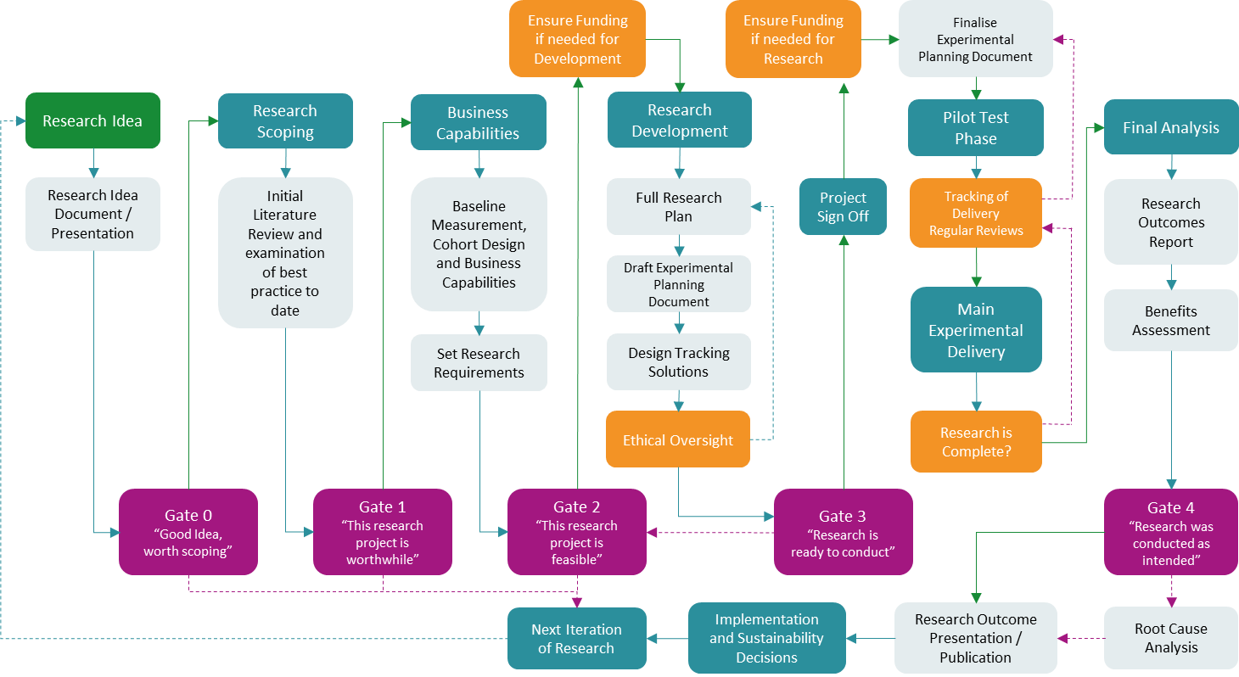
Research Project Lifecycle
Reference: Olphin, T.P.A. (2023). Research Project Lifecycle: A Structured Approach to Conducting Research in the Public Sector. Reading, UK: Thames Valley Violence Reduction Unit. @ Crown Copyright 2023

Slide 24
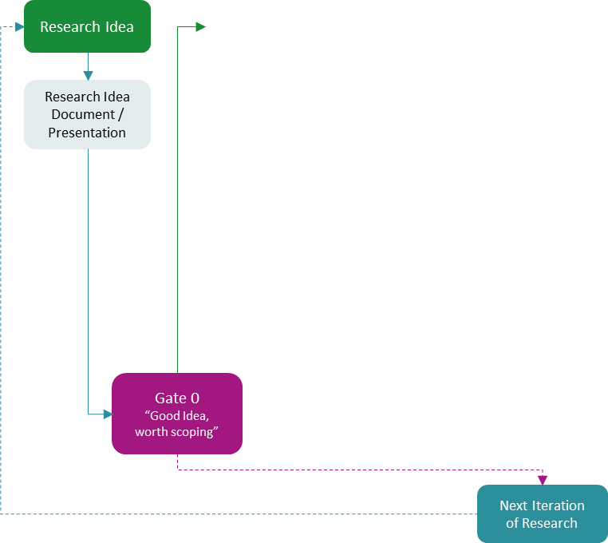
Ideas and Gate 0
“One of the most valuable things we can do to start with is acknowledge where we know nothing”
Both exciting and terrifying… most things delivered in the public sector have not been tested well
Encourage many ideas, some will naturally turn out to be smaller
Find areas of boom and bust funding
Using something that already exists, but too many cases to work with
Untested interventions that partners are about to start anyway

Slide 25
Ideas and Gate 0
“One of the most valuable things we can do to start with is acknowledge where we know nothing”
Both exciting and terrifying… most things delivered in the public sector have not been tested well
Encourage many ideas, some will naturally turn out to be smaller
Find areas of boom and bust funding
Using something that already exists, but too many cases to work with
Untested interventions that partners are about to start anyway

Slide 26
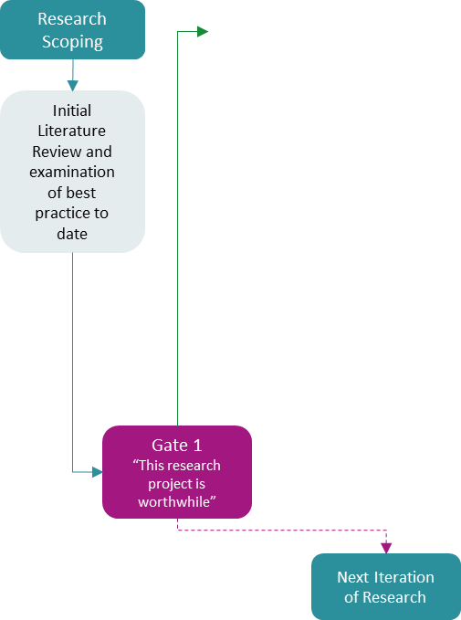
Research Scoping and Gate 1
“More likely to have an impact = Smaller experiment needed to test”
Design the best intervention you can, based on prior evidence:
  Use existing literature reviews as a base
  Rapid evidence review is possible to do swiftly, make sure to summarise detail
  Out of the evidence that is strongest:
    What works best, what works less?
    What power is likely
    What cohorts have been most effective
    How should it be designed?
    What are the elements that would make the best possible intervention
    Pay attention to context
      “Cambridge is not Chicago”

Slide 27
Research Scoping and Gate 1
“More likely to have an impact = Smaller experiment needed to test”
Design the best intervention you can, based on prior evidence:
  Use existing literature reviews as a base
  Rapid evidence review is possible to do swiftly, make sure to summarise detail
  Out of the evidence that is strongest:
    What works best, what works less?
    What power is likely
    What cohorts have been most effective
    How should it be designed?
    What are the elements that would make the best possible intervention
    Pay attention to context
      “Cambridge is not Chicago”

Slide 28
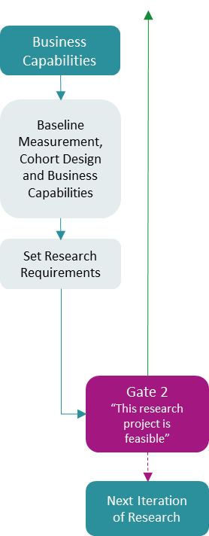
Business Capabilities and Gate 2
“More likely to have an impact = Smaller experiment needed to test”
“The fundamentals of research are the most important part: Spending time on baseline measurements and planning saves far more time and effort later”
Maximise Likely Effect Size
Design the best cohort you can, based on prior evidence
  Identify cohorts with higher likelihood of the unwanted outcome?
  Ideally avoid expert judgment identification
  Which groups are more likely to be paid for afterwards?
Make sure you can actually deliver the intervention
  Two small complete trials beats one unfinished trial
  Partner up with other areas and share the load
  What caseloads can be managed – Effective Staffing

Slide 29
Business Capabilities and Gate 2
“More likely to have an impact = Smaller experiment needed to test”
“The fundamentals of research are the most important part: Spending time on baseline measurements and planning saves far more time and effort later”
Maximise Likely Effect Size
Design the best cohort you can, based on prior evidence
  Identify cohorts with higher likelihood of the unwanted outcome?
  Ideally avoid expert judgment identification
  Which groups are more likely to be paid for afterwards?
Make sure you can actually deliver the intervention
  Two small complete trials beats one unfinished trial
  Partner up with other areas and share the load
  What caseloads can be managed – Effective Staffing

Slide 30
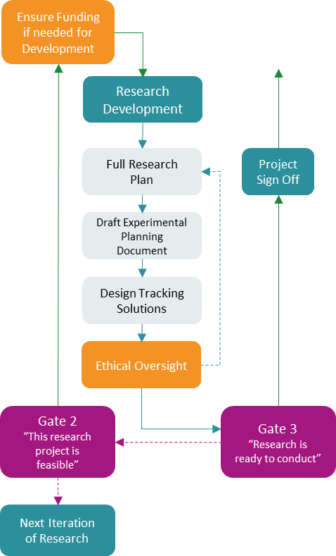
Research Design and Gate 3
“There are many different ways of solving a problem”
Be inventive
Most efficient mechanism of delivery (maximise your reach for the money)
Be clear what you are testing and keep it simple
Choose something you can deliver (in your zone of control)
Most ethical version of what can be delivered; often considering this helps to make it smaller
Accurate tracking ensures you find out early if things are not going to plan
More uptake (less dropout)
  Design out barriers
Realistic environment
  More similar to business as usual, often more likely to be delivered
  It can make it more tricky to find a good way, it can also allow for some interesting free experiments
Motivated delivery
  If the people delivering the intervention believe in it, they are more likely to keep to it

Slide 31
Research Design and Gate 3
“There are many different ways of solving a problem”
Be inventive
Most efficient mechanism of delivery (maximise your reach for the money)
Be clear what you are testing and keep it simple
Choose something you can deliver (in your zone of control)
Most ethical version of what can be delivered; often considering this helps to make it smaller
Accurate tracking ensures you find out early if things are not going to plan
More uptake (less dropout)
  Design out barriers
Realistic environment
  More similar to business as usual, often more likely to be delivered
  It can make it more tricky to find a good way, it can also allow for some interesting free experiments
Motivated delivery
  If the people delivering the intervention believe in it, they are more likely to keep to it

Slide 32
A Personal Aim
Many ideas, scoped at gate 3
Ready to go when we have
  Funding
  No overlap
  Political Desire
Avoid cohort overlap and trial overlap
  The more tests you have, the more complications there are with tracking and ensuring no overlap of trials, but it is possible
  Pause here if not ready yet

Slide 33
A Personal Aim
Imagine as a funder, or commissioner of services, always getting well scoped trials, with evidence behind choices that have been made, and confidence behind delivery

Slide 34
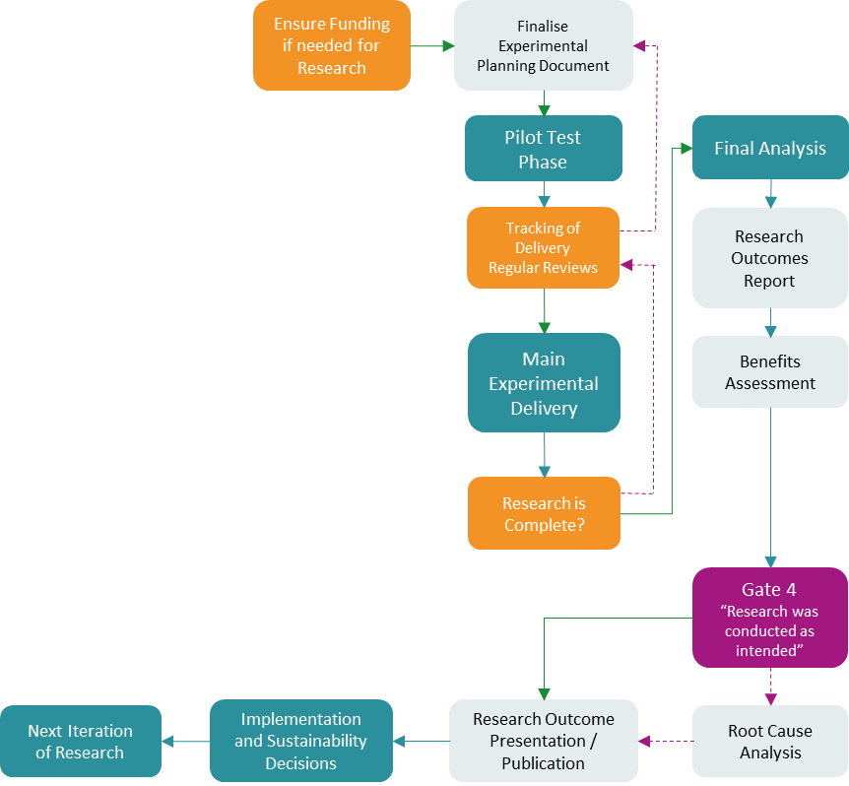
Delivery and Gate 4
Run Pilot Tests
  Ensure realistic caseloads to be able to deliver a good service
  Spot issues early
Interim Analysis can allow for earlier results
Avoid scope creep
Learn from your mistakes, and allow others to as well
Share what you learned, and make it more likely that more research will be wanted

Slide 35


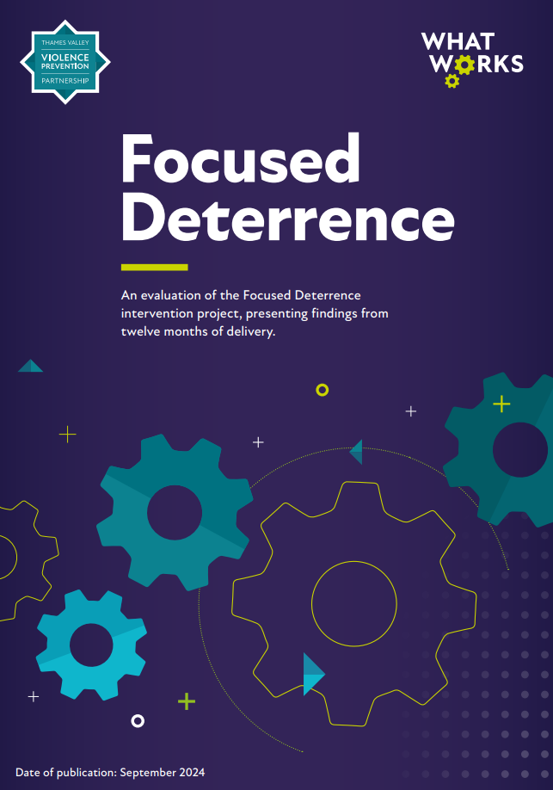
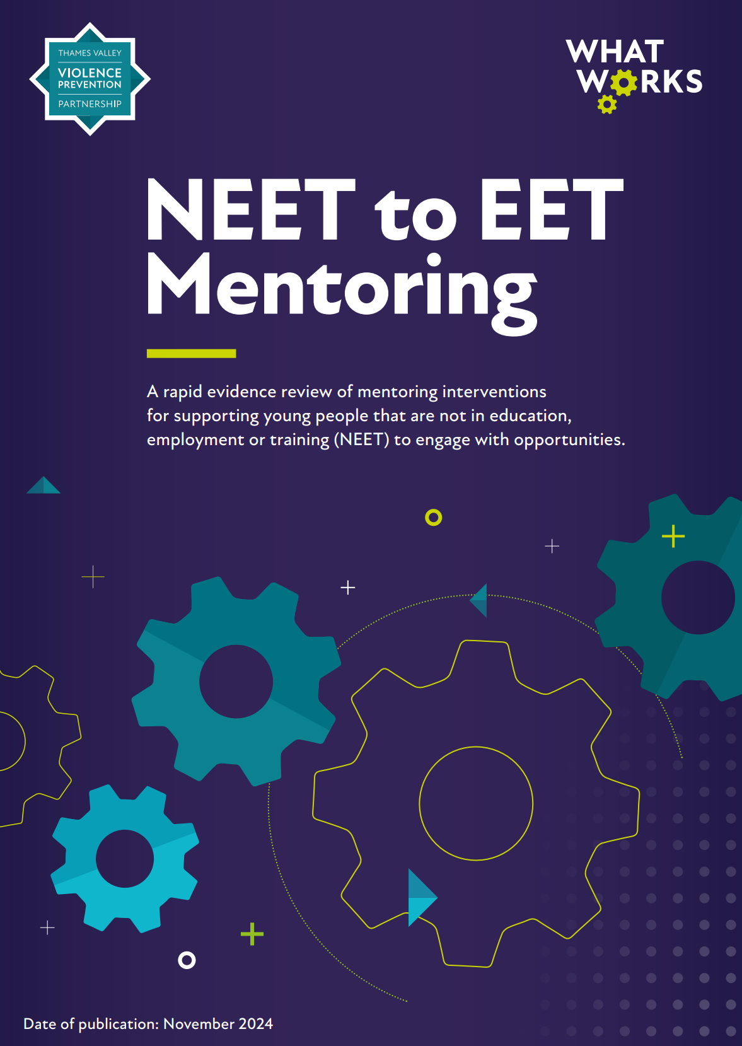
What comes out of this…

Slide 36
Research Project Lifecycle
Reference: Olphin, T.P.A. (2023). Research Project Lifecycle: A Structured Approach to Conducting Research in the Public Sector. Reading, UK: Thames Valley Violence Reduction Unit. @ Crown Copyright 2023

Slide 37
Not just research…
Works for every implementation project
  Is it based on evidence?
  Do we need to test it first?
  What is the best way to achieve it?
  How is it likely to work?
  What cohort will it work best for?
  What is the most efficient and effective way to deliver this change?

Slide 38
This can be stolen with pride
Provides a structure for your research team to run internal research
Open source model that anyone can use
It can contribute to allowing you to run high quality research in all areas

Slide 39
It is possible for all areas of the country to be adding to the evidence base, and
Targeting interventions that work at the people who need them

Slide 40
To Reference, and Contact Details
Olphin, T.P.A., (2023). Research Project Lifecycle: A Structured Approach to Conducting Research in the Public Sector, Reading, UK: Thames Valley Violence Reduction Unit
© Crown Copyright 2023. This information is licensed under the Open Government Licence v3.0
Tori Olphin, M.B.E.
Head of Data Science, Research and Evaluation, Thames Valley Violence Prevention Partnership
Director of Research, ResearchCore
Email: tori@researchcore.co.uk or tori.olphin@thamesvalley.police.uk
Mobile: +447921 808988

Slide 41
Break and Poster Session
10:45 to 11:15

Slide 42
Identifying evidence gaps and building the evidence base
Dr Laura Knight
Head of Toolkit

Slide 43
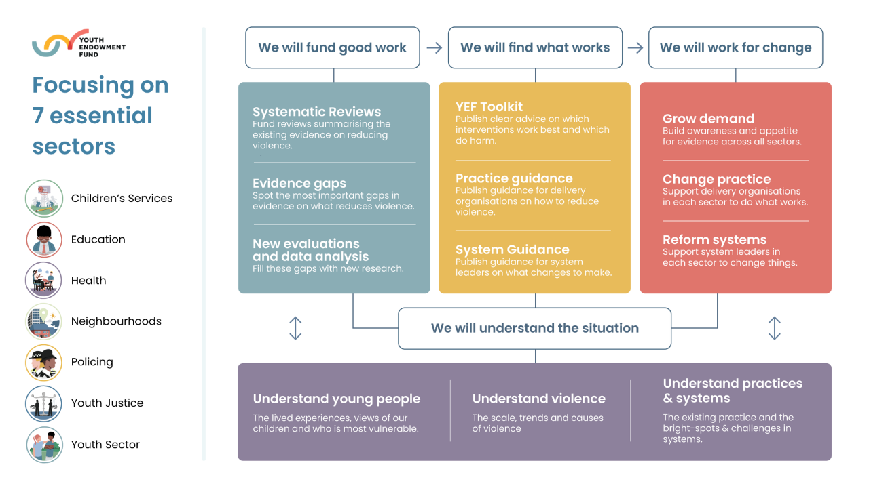

Slide 44

Evidence products
Check lists
Guidance
Evidence platform
Evidence map
Database
Systematic review
Primary studies
Data
Evidence portal
Implementation resources
Practice guidance
Systems guidance
Toolkit
Technical reports
Programmes EGM
Systems EGM
Effect Size Database
YEF funded projects

Slide 45
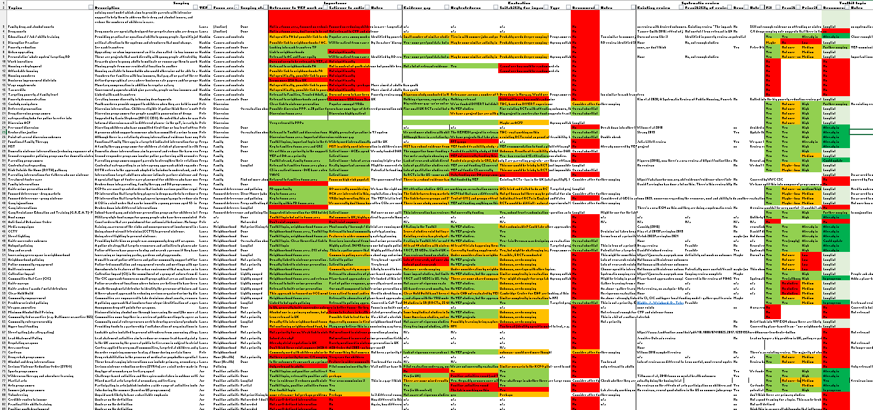
Scoping for evidence gaps
Approach and description
Relevance and salience
Evidence gap
YEF impact eval
Evidence synthesis
Toolkit
154 approaches

Slide 46
Evidence gap shortlisting
Step 1
Long list of approaches to violence prevention
Step 2
Scope approaches for YEF impact evaluation
Step 3
Scope approaches for evidence synthesis and Toolkit entries
Step 4
Sector opportunity reports
- Evaluations
- Data projects
- Change work
Quarterly Evidence Gaps meetings

Slide 47
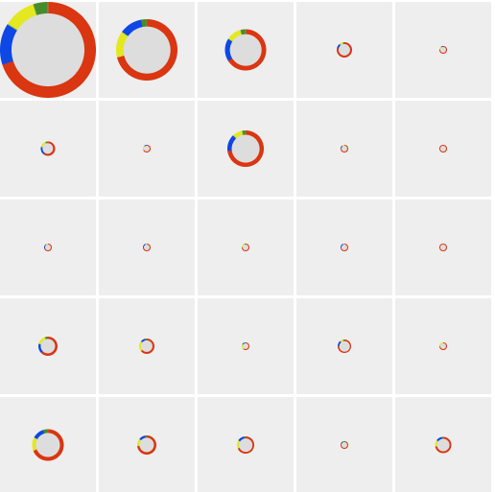
YEF Programmes Evidence and Gap Map
SUPPORT POSITIVE BEHAVIOUR
ADDRESS
PROBLEM BEHAVIOUR
FAMILY AND CARER
SYSTEMS APPROACH
CRIME AND
JUSTICE
INTERVENTIONS
CHILD CENTRED
High and medium quality evaluations
Low quality evaluations
FAMILY AND CARER
Low quality systematic reviews
High and medium quality reviews
OUTCOMES
PEER AND
ADULT
SCHOOL PROFESSIONALS
COMMUNITY
OFFENDING AND
CRIME

Slide 48
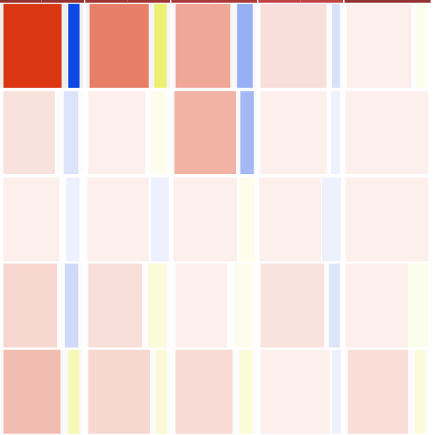
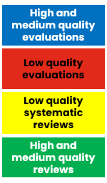
YEF Programmes Evidence and Gap Map
SUPPORT POSITIVE BEHAVIOUR
ADDRESS
PROBLEM BEHAVIOUR
FAMILY AND CARER
SYSTEMS APPROACH
CRIME AND
JUSTICE
INTERVENTIONS
CHILD CENTRED
FAMILY AND CARER
OUTCOMES
PEER AND
ADULT
SCHOOL PROFESSIONALS
COMMUNITY
OFFENDING
CRIME

Slide 49
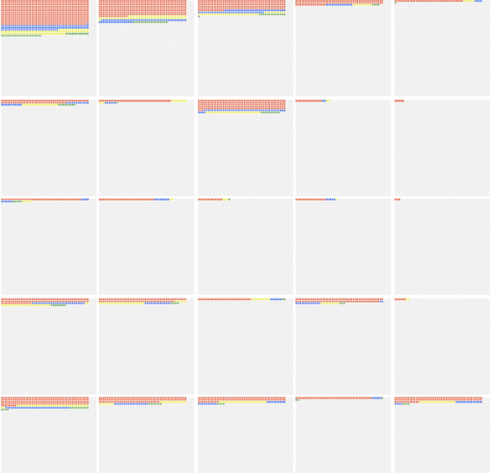
YEF Programmes Evidence and Gap Map
SUPPORT POSITIVE BEHAVIOUR
ADDRESS
PROBLEM BEHAVIOUR
FAMILY AND CARER
SYSTEMS APPROACH
CRIME AND
JUSTICE
INTERVENTIONS
CHILD CENTRED
FAMILY AND CARER
OUTCOMES
PEER AND
ADULT
SCHOOL PROFESSIONALS
COMMUNITY
OFFENDING
CRIME

Slide 50
YEF Programmes Evidence and Gap Map
SUPPORT POSITIVE BEHAVIOUR
ADDRESS
PROBLEM BEHAVIOUR
FAMILY AND CARER
SYSTEMS APPROACH
CRIME AND
JUSTICE
INTERVENTIONS
CHILD CENTRED
FAMILY AND CARER
OUTCOMES
PEER AND
ADULT
SCHOOL PROFESSIONALS
COMMUNITY
OFFENDING
CRIME
Notes:
We have more evidence on:
Interventions to support positive behaviours
Interventions to address problem behaviours
Interventions focused on parents/main carers
We have less evidence on:
Systems-based approaches
Interventions targeted at reducing child exploitation
Interventions working with over-represented groups in the criminal justice system

Slide 51
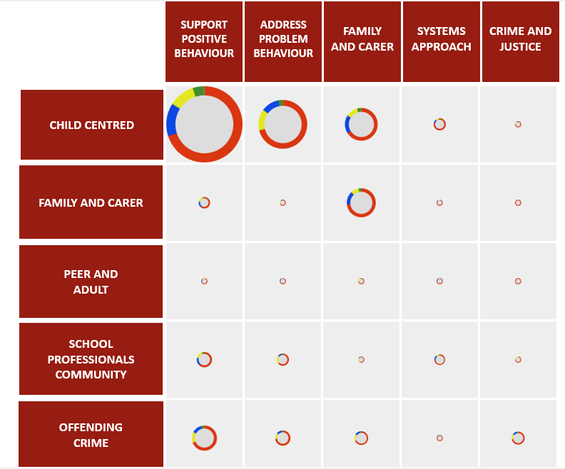
YEF Programmes Evidence and Gap Map
We have more evidence on interventions addressing:
positive behaviours
problem behaviours – particularly violence, alcohol and drugs, bullying
  BUT – this is largely low quality
parents and carers
Key evidence gaps:
child exploitation
contextual safeguarding
criminal networks
interventions for children with characteristics over-represented in the CJS
systems approaches

Slide 52
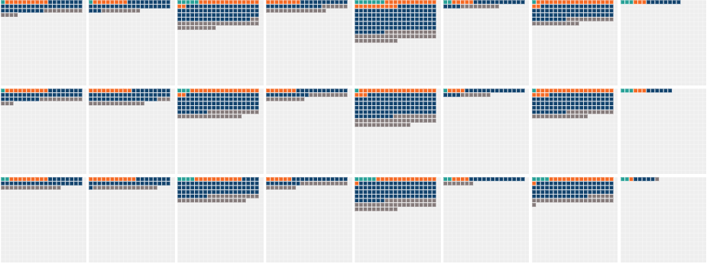


YEF & DfE Systems Evidence and Gap Map
LIT REVIEWS HIGH/MED QUALITY
OTHER HIGH/MEDIUM QUALITY
EVALS
HIGH/MED QUALITY
ALL STUDIES LOW QUALITY
EDUCATION
HEALTH
SOCIAL CARE
WELFARE
CRIME AND JUSTICE
COMMUNITY
MULTI SECTOR
NON-SPECIFIC
INTERACTIONS WITH SYSTEMS OF SUPPORT
PRACTITIONERS VIEWS
GENERAL COMMENTARY
Notes:
The majority of papers featured content on the ‘crime and justice system’ (61%), social care system (42%) and multi-sector insights (39%).
The Systems EGM also found some possible gaps in the research evidence:
In general, we found few literature reviews (just 7% of total papers), suggesting that not much work has been undertaken to summarise the existing literature.
Only 3% of the total papers in the map were dedicated to co-production. Of these studies only one was a high or medium quality evaluation and none were high or medium quality reviews. This suggests a gap in our knowledge about co-production approaches to reducing young people’s involvement in violence.
Very few papers discussed Violence Reduction Units (VRUs) (less than 1%), which may suggest a gap in the literature about the role of VRUs. Though this is expected since VRUs were established in 2019 in England and Wales, this does not take away from the suggestion that future research examining VRUs could be useful.
Studies that broke down their findings by gender or race were very limited.
Compared to the themes of access to and engagement with systems of support (which both featured in 48% of the papers), few papers included an investigation of the way young people and their families navigated through different systems (22%).

Slide 53
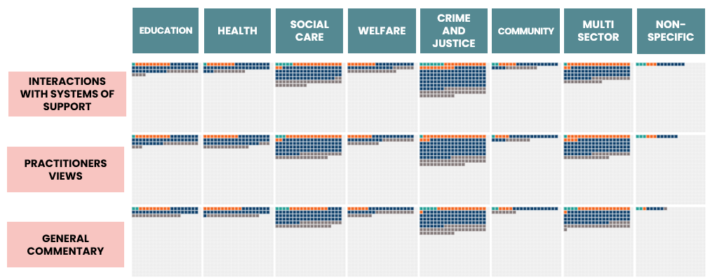
YEF & DfE Systems Evidence and Gap Map
We have more papers on:
Crime and justice system
Social care system
Multi-sector systems
Access to, and engagement with systems
Key evidence gaps:
Co-production
Findings by characteristics, gender and race
How children and families navigate through systems

Slide 54

Behind the Toolkit
Evidence and Gap Map (EGM)
Systematic reviews of primary studies
Toolkit technical reports
Toolkit strands
1,759 impact studies
427 process evals
280 systematic reviews
Commissioned 15 new reviews
Academic and practitioner peer review
Academic and practitioner peer review
Notes:
Systematic reviews we paid for:
Mentoring, MST, Sports, Adventure and wilderness therapy, FFT, Arts participation, Stop and search, School exclusions update, Summer programmes, Post-custody resettlement progs, Restorative justice (update), Nutrition, CtC, FD, Place-based approaches

Slide 55
Effect Size Database
1,217 studies
c.12,000 on child-centred outcomes
c.2,500 on offending and crime
Examine the distribution of effects across
  outcomes – violence, crime, antisocial behaviour, behavioural difficulties…
  Intervention types – positive activities, social and emotional learning…
  Settings – schools, community…
Provide expected effect sizes for sample size calculations for impact evaluations
Use as a ‘second coder’ in meta-analysis

Slide 56

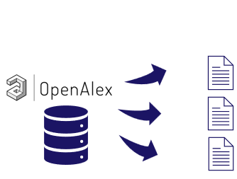




“Living” Programmes Evidence and Gap Map
Latest status of studies across approaches / population / setting etc
Machine learning models add papers to Toolkit topic groups
Humans:
Quality appraisal
Data extraction
Meta-analysis
Reporting
Maintains a surveillance of the literature
Highlights text for data extraction and quality appraisal

Slide 57
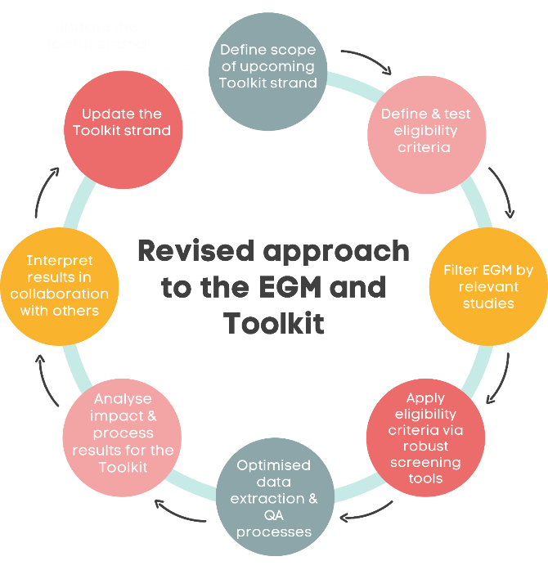
COMBINED
Evidence and Gap Map
&
Effect Size Database
New approach to updating the Toolkit, live from April 2025

Slide 58
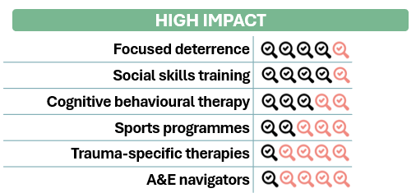
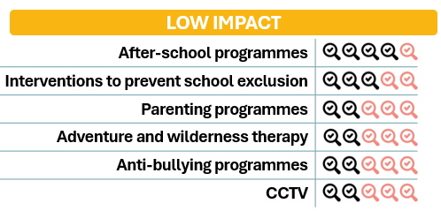
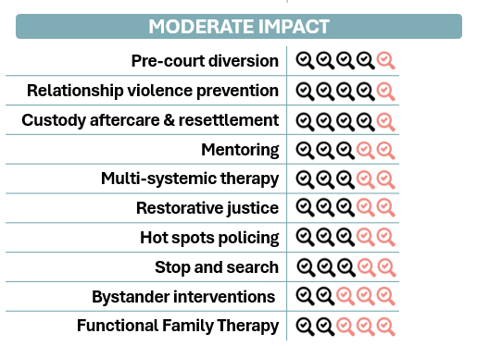

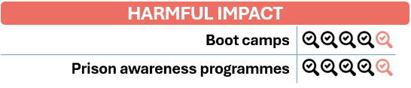
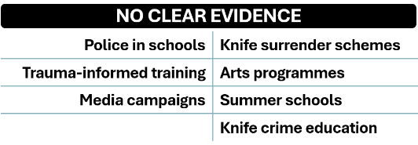

Slide 59
Planned updates to the Toolkit
Feb 25 - Mar 26
Summer employment programmes
Nutrition programmes
Restorative justice
Communities that Care
Cognitive Behavioural Therapy
Apr 26 - Mar 27
Trauma-informed training
Parenting programmes
Anti-bullying programmes
School exclusions
Social skills training
Apr 27 - Mar 28
Mentoring
Police in schools
Summer employment programmes
Multi-systemic therapy
Functional Family Therapy
Apr 28 - Mar 29
Restorative justice
Pre-court diversion
Focussed deterrence
Communities that Care

Slide 60
Currently scoping for the Toolkit
Social skills training Universal provision Targeted provision | Interventions to prevent school exclusions Behaviour management Supporting attendance | Pre-court diversion Outcome 22 Community Resolution Conditional Cautions
Sports programmes Team sports Combat sports | CBT Clinical provision CBT techniques | Trauma-specific therapies - Breakdown by types
Community sentences | Youth clubs | Interventions to prevent criminal exploitation
Community level investment | Detached youth work | The ‘Cardiff Model’ of multi-agency data sharing
Poverty reduction Income support Housing | Speech and language therapy | Custody navigators

Slide 61
Keep in touch
Laura.Knight@youthendowmentfund.org.uk

Slide 62
How do I know whether it is working and how? From tracking to experimentation
Dr. Peter NEYROUD, Associate Professor in Evidence-based Policing
Institute of Criminology

Slide 63

Overview
Preparation
Mapping the process
Getting expert advice and support
Piloting
Live running
Tracking and reporting

Slide 64

Evidence Based
Policing
“the use of the best available research on the outcomes of police work to implement guidelines and evaluate agencies, units, and officers”
(Sherman, 1998: 3)

Slide 65
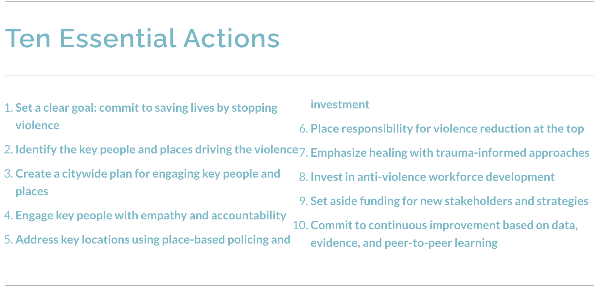

Doing your pre-intervention research thoroughly

Slide 66
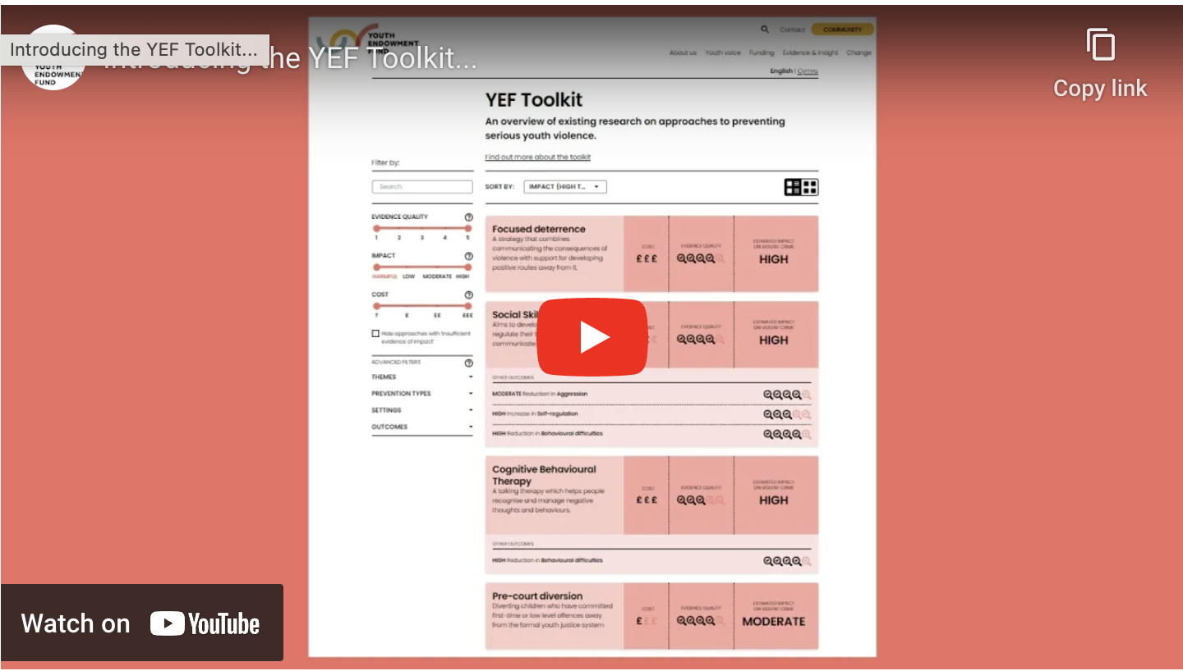

Using trusted sources

Slide 67

Systematic Reviews

Slide 68
Systematic Reviews in Policing: What works? What’s promising? What doesn’t work?
What works? | What’s promising? | What doesn't work?
Hot spots policing | Information-gathering interrogation method | Second responder programs
Focused deterrence Diversion from Prosecution | Programs to increase procedural justice and enhance legitimacy | Stress management programs
Problem-oriented policing | Third Party Policing | Community policing to reduce crime
Directed patrol for gun violence | Community Policing to enhance legitimacy | Formal processing of young offenders
Neighbourhood watch | Body Worn Cameras | Juvenile curfews
DNA for police investigations | to gather evidence and enhance legitimacy | Counter-narratives to combat radicalization
68

Slide 69
Partnerships and supported study
What research and tracking can we do ourselves?
What might we need specialist support for?
Using crime, call and other force data for pre-implementation base line, tracking and outcomes
Hotspot maps
Offending data
Descriptive and exploratory studies
Large data models for risk frameworks
Experimentation – quasi-experiments and randomised controlled trials
Cost benefit

Slide 70
From idea to implementation: research in action
What are the aims, measures and outcomes?
What is the control: prior data or comparison area?
Testing the systems and processes and the data
Managing a live intervention: observation, data and tracking
Cost benefit, clear guidance and managed implementation
Baseline
What is your starting point?
Pilot/pre-testing
Preparation and de-bugging
Operational phase
Wider implementation?

Slide 71
Targeting the most Harmful: Philadelphia & UK: using big data
High Risk (2%)
Neither High nor Low Risk (38%)
Low Risk (60%)

Slide 72
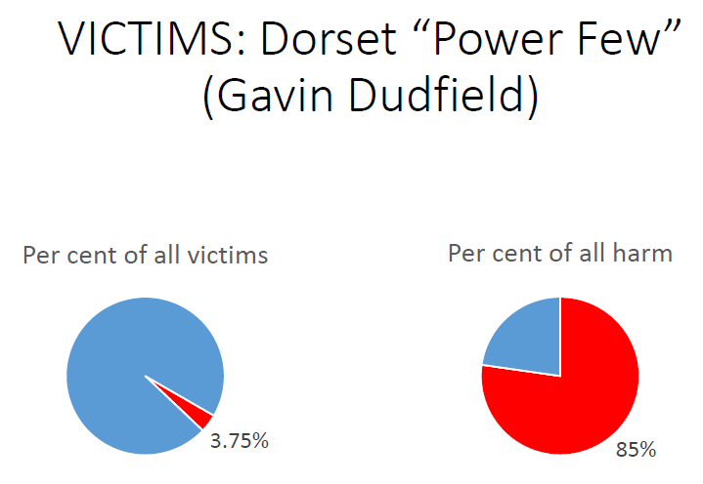
Descriptive data example: “The most Harmed”: 3% of Victims – 85% of all harm

Slide 73
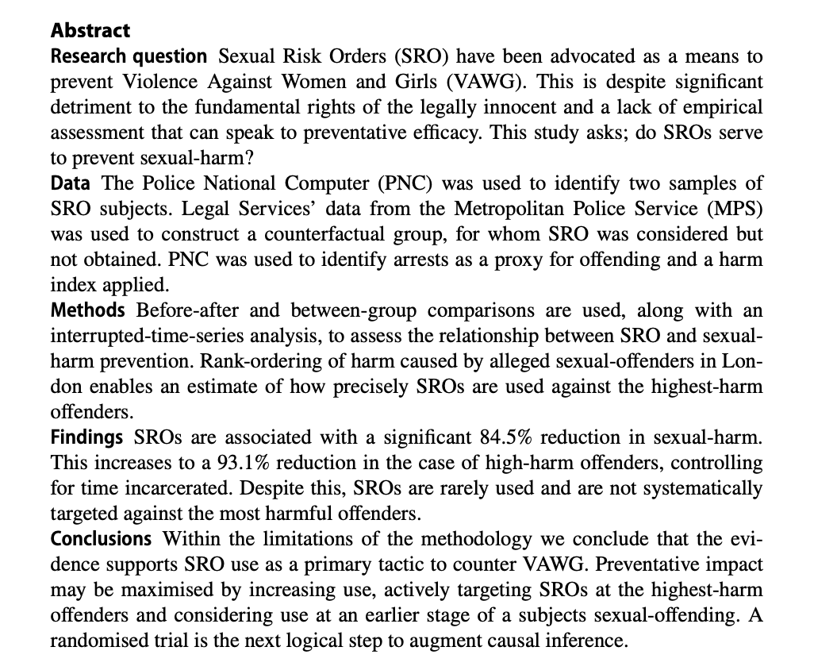
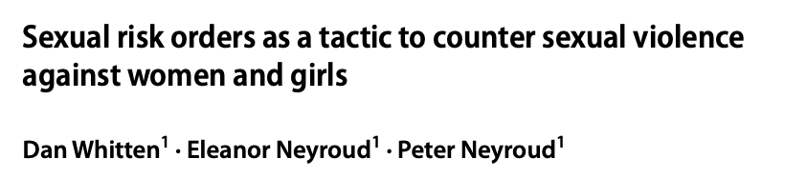
Descriptive comparison with a control

Slide 74
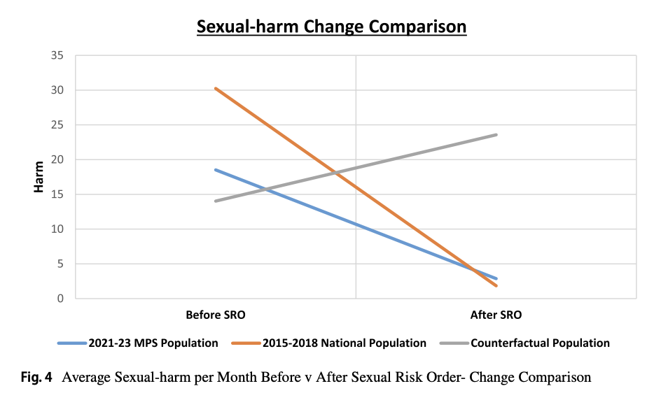
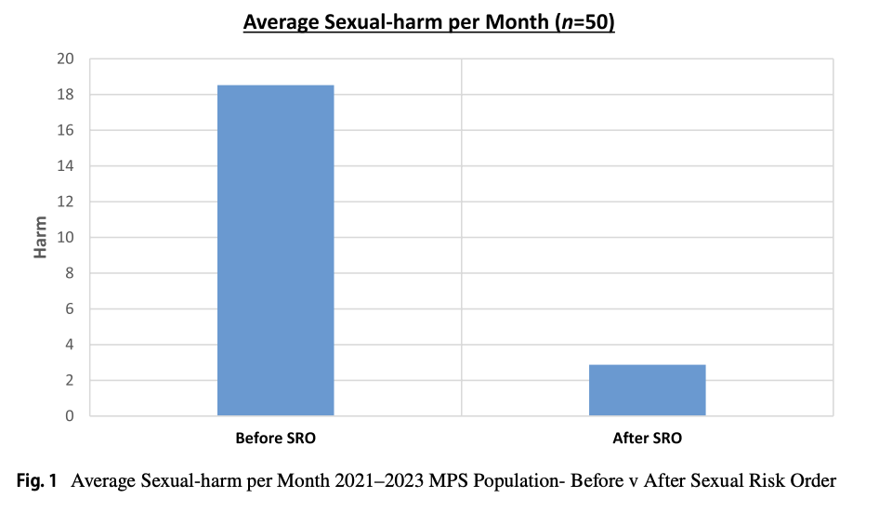
Add harm and change comparison over time

Slide 75
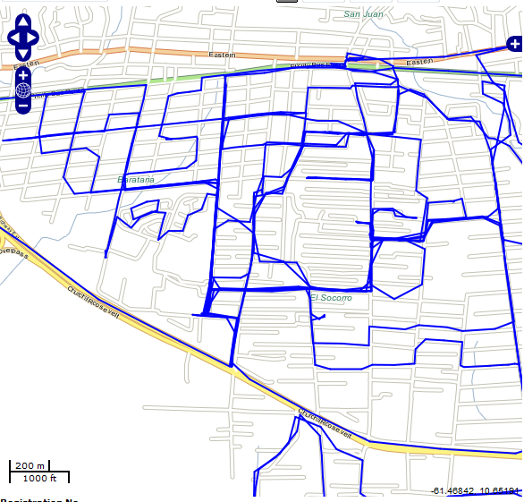
Copstat: Tracking deployment shift by shift: Trinidad and Telengana, India
Oct 31 6PM-8AM

Slide 76
Tracking:
Bi-Weekly Bar Graphs
Total Patrol Time Delivered
Total Time in Hot Spots
Total Time out of hot spots
Percent of patrol time in hot spots

Slide 77
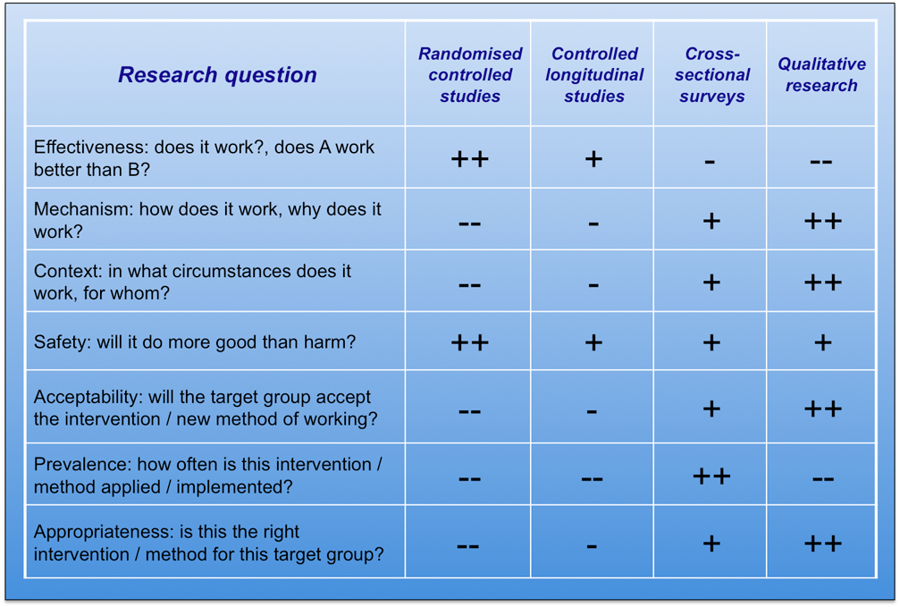
Which design for which question? Do you need mixed methods?
Explanation

Slide 78
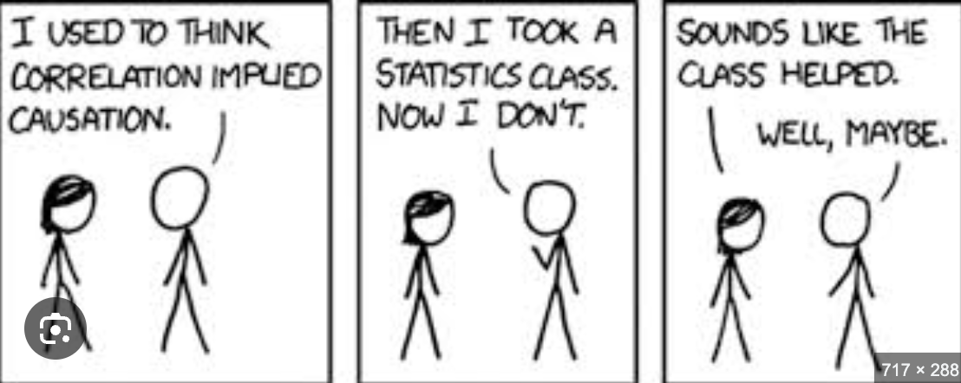
Avoiding the “intervention causal fallacy”

Slide 79
Did it work? Doing experiments well enough to know
Rapid Video Response
Intensive patrols of violent hotspots
Operation Turning Point

Slide 80
The challenge of experimentation
Balancing a large enough experiment to be confident of seeing a difference with one that is controllable,
with as few confounding factors as possible
and as homogeneous a sample as possible
And, for the likelihood of future implementation, keeping the experimental conditions as close as possible to normal day to day
And then replicating it
Not once but preferably more and in different contexts

Slide 81
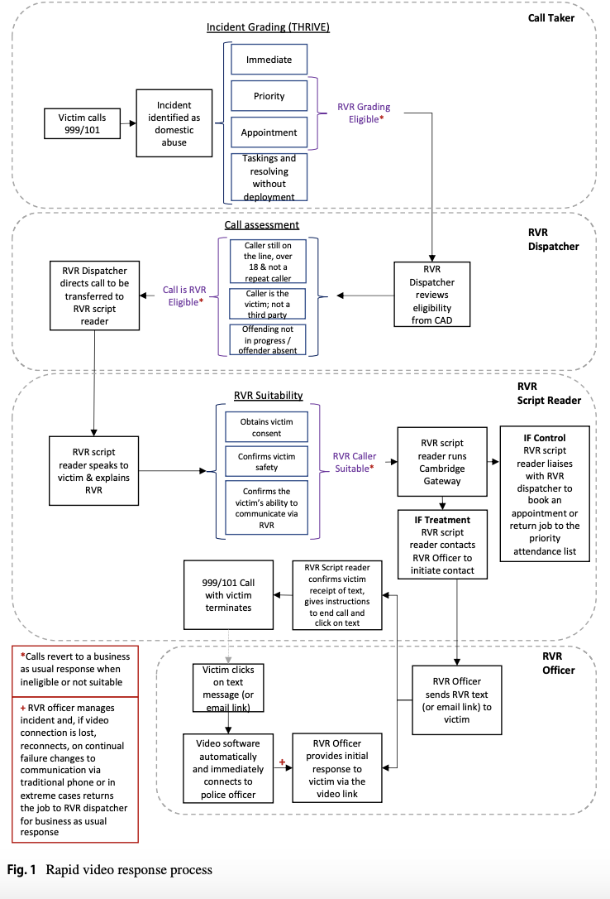
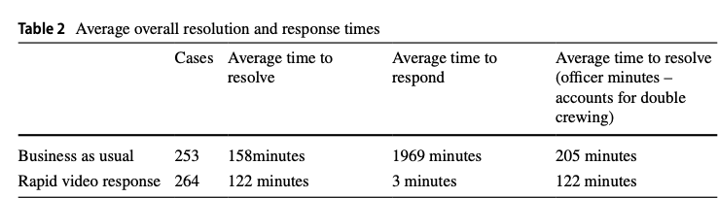
Rapid Video Response in Kent and replication/expansion in Dorset

Slide 82
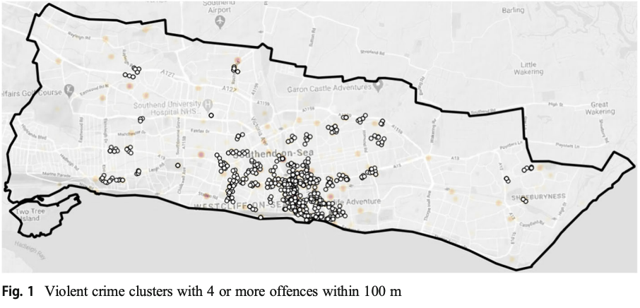
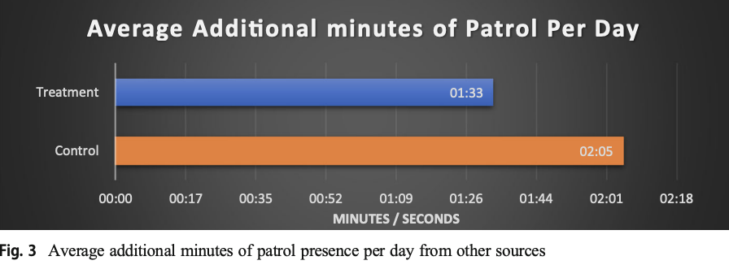
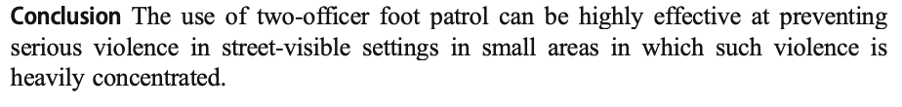
Hotspots of violence: Southend and then GRIP

Slide 83
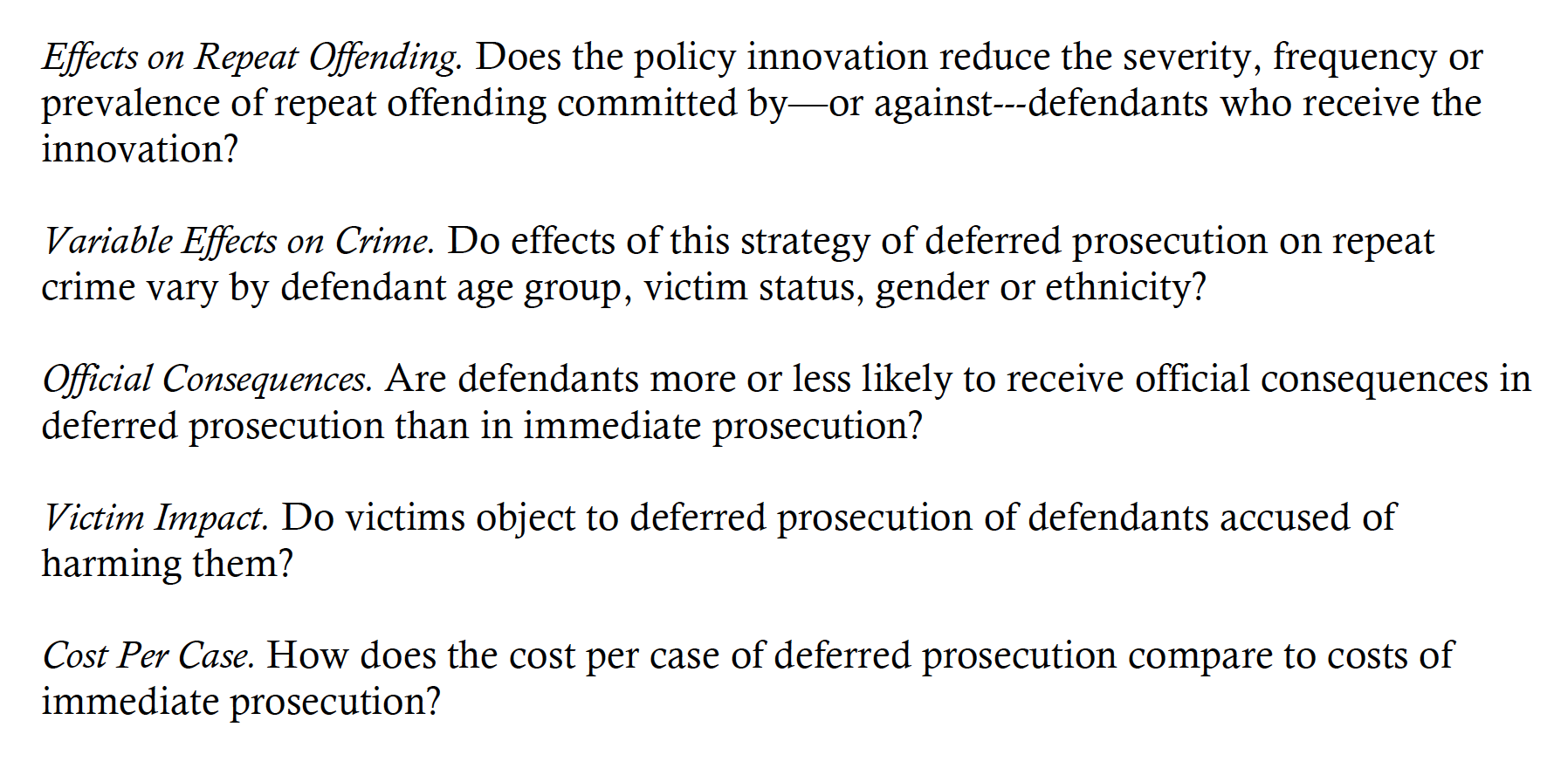
Operation Turning Point(s), Checkpoint and Chance to Change

Slide 84
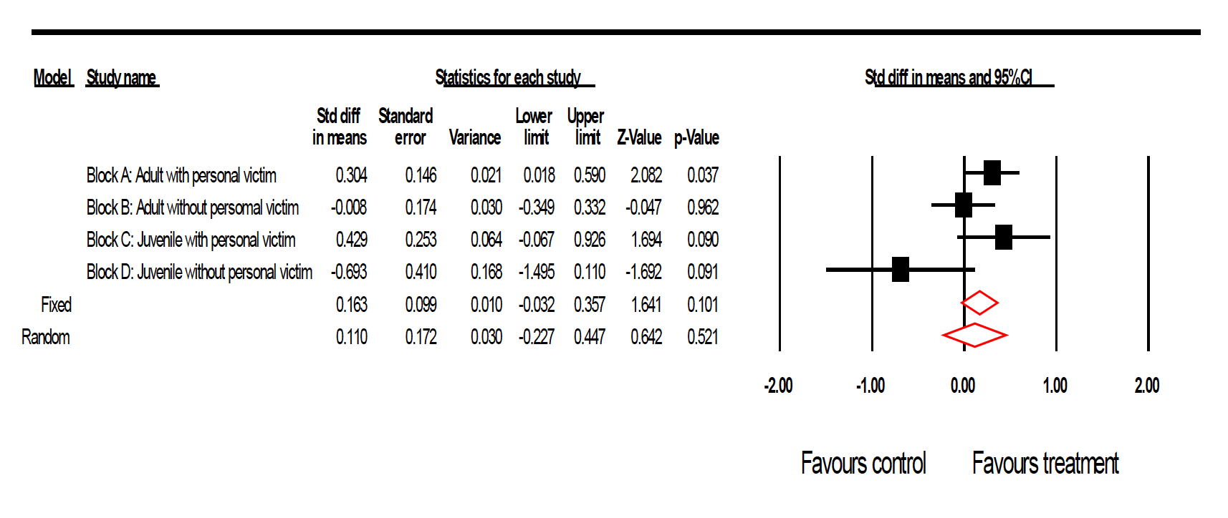
And always remember that most interventions do not work consistently across whole populations.

Slide 85
Golden rules?
Do your preparation thoroughly
  Read the systematic reviews and prior studies
  Start with best chance of something that should work and learn from others who have tried it
Pilot with care and use it to improve before live implementation
Do no harm
Be honest and transparent: publish (internally at least) your protocol and stick to it – don’t cheat!
Publish the results – preferably to the widest audience – but definitely to policing colleagues and be honest.

Slide 86
Lunch!

Slide 87
Closing Thoughts

