Slide 1


Preventing Youth Violence: Research & Evidence Conference 2025
Mentoring

Slide 2
YEF Reach Project
DR Charlotte Coleman
Anna Stevens, Bernadette Stiell, Ben Partridge, Sean Demack

Slide 3
Reach - Background
YEF funded Feasibility, Pilot and Efficacy evaluations
Results of Feasibility
Update on Pilot and Efficacy
Targeted intervention for 11-16 year olds at risk of suspension from school.
Utilises the ‘teachable moment’
Trained Youth Workers deliver one-to-one support sessions to improve confidence, wellbeing, resilience and relationships

Slide 4




Feasibility study
Data collection Dec 21- Sep 22
• Qualitative interview data
Delivery leads
Youth workers
Young people
School leads
Observations of sessions
Survey of Youth Workers
Collated monitoring data

Slide 5
Feasibility Study Success/Target criteria
Target Set | % Achieved | Status
Attendance of YP at planned sessions | 95% (n sessions attended = 1,230 out of a total of n sessions offered = 1,289) | Green
Of those that are successfully recruited to the programme, the percentage that will go on to complete the full programme | 88% (at the time of reporting n = 14 completions out of a total of n = 16 that started at least six months prior; please see below for details) | Green
YWs rating of how far they agree as to whether the YP they are working with has made progress as expected (strongly agree to disagree). | 71% (n = 52 strongly agree/agree out of a total of 73) | Green

Slide 6
Findings - Matching process & relationship building phase:
Have YP been allocated to a suitable YW?
Matching not easy using demographics – mostly female YWs – but wasn’t an issue - allocation to YWs was generally successful.
YWs ‘advertised’ their profiles and YPs selected who they wished to work with. This helped achieve common ground and shared experiences.
"We made one-page profiles of ourselves… we thought actually why don’t we do it a bit different, why don’t we talk about ourselves and then they choose us?”
“Actually if you look at the engagement rate, regardless of male involvement the retention rate’s been relatively high, it’s interesting that the females that are working with the male young people that we’ve got on the programme, that actually isn’t affecting engagement or their ability to continue on the programme, they’ve not declined the intervention based on the youth worker’s gender.”

Slide 7
Findings - Matching process & relationship building phase:
Is the relationship building phase successful?
What was important was the engagement given when building the relationship.
‘They’ve all engaged really really well; they’re all meeting that sort of, developing that relationship with the YW from the start, so everyone’s hitting that component in terms getting that relationship.’
"For me, with the young people, they have to feel safe and secure around me. They’ve got to feel that I will listen. …, it’s making them feel at ease, making them feel equal, making them feel respected, making them feel listened to, and then straight away you can start to build a good relationship with them. And obviously you don’t judge them."

Slide 8
Findings - Matching process & relationship building phase:
Also important was having a flexible, young person-led approach where trust could be built.
‘She tries to listen to me – she tries to make us feel like we’re on the same level so that she can talk to me and I can talk to her as well.’
"It works pretty well, four to six weeks. The good thing about this programme is it’s flexible. If you’ve got a young person that’s going to take a little bit longer to build a relationship, you’ve got the time to do that. So, yeah, with him it’s been a little bit longer."

Slide 9




Any questions?
@sheffhallamuni
@sheffieldhallamuniversity
@sheffhallamuni
@sheffhallamuni

Slide 10

Girls & Young women’s Mentoring programme
(Maia & Lift Programme)
Nickiesha Henry (nickiesha.henry@london.gov.uk)
Eleanor Parker (eleanor.parker@london.gov.uk)

Slide 11

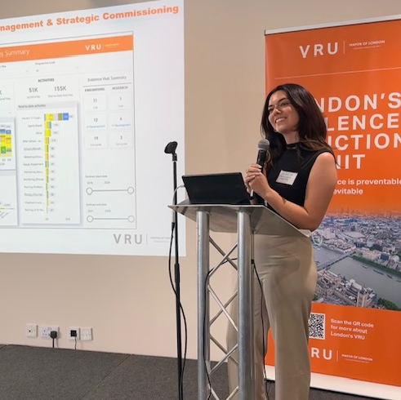

Introduction
NICKIESHA HENRY
Programme Manager
ELEANOR PARKER
Research and Performance Analyst
Notes:
The London Violence Reduction Unit (VRU) was set up to tackle the root causes of violence across the city, with a focus on reducing violent crime through a public health approach. While data shows that boys are more likely to experience violence, the VRU recognises that girls face different forms of violence. Therefore, the VRU Women and Girls Team was first developed in recognition that exposure to gender-based violence in childhood has a significant adverse experience with long term impacts on health, wellbeing and safety outcomes. Therefore, in adopting a public health approach, the VRU has taken on a co-ordinated and preventative approach to tackling VAWG, raising awareness of the issues and supporting those affected.
With in our Women and Girls team, we are also able to support other teams across the Violence Reduction Unit to consider the specific needs of girls and young women in the design and delivery of their violence reduction programmes, for example across education and parenting programmes.

Slide 12

Notes:
The London Violence Reduction Unit (VRU) was set up to tackle the root causes of violence across the city, with a focus on reducing violent crime through a public health approach. While data shows that boys are more likely to experience violence, the VRU recognises that girls face different forms of violence. Therefore, the VRU Women and Girls Team was first developed in recognition that exposure to gender-based violence in childhood has a significant adverse experience with long term impacts on health, wellbeing and safety outcomes. Therefore, in adopting a public health approach, the VRU has taken on a co-ordinated and preventative approach to tackling VAWG, raising awareness of the issues and supporting those affected.
With in our Women and Girls team, we are also able to support other teams across the Violence Reduction Unit to consider the specific needs of girls and young women in the design and delivery of their violence reduction programmes, for example across education and parenting programmes.

Slide 13

Background to support for girls and Young Women
Need
Response
Learning
PILOT PROGRAMME
Consultation with the sector and YPAG
Evaluation findings of the pilot directly informed the commissioning of the Community-based Mentoring Programme
LOT 1: Intensive training for staff working with young women and girls in school settings.
Safe spaces & Support for Girls and Young Women
LOT 2: A community-based support service offering safe spaces and mentoring for young women (9-25 years), with a tailored programme for 18-25-year-olds navigating the adult system.
Training for teachers and staff in Youth Settings with a gendered approach
Notes:
Recognising the distinct challenges faced by girls and young women, there was a need to address the specific forms of violence they experience, such as exploitation, peer abuse, and the impact of unhealthy relationships.
While the wider VRU strategy has primary focused on boys due to the higher prevalence of violent victimisation, this new initiative acknowledges the need for tailored support for girls, providing a safe space for them to build resilience, gain confidence, and access the support they need to navigate these challenges. This targeted approach aims to ensure that all young people, regardless of gender, have the support they require to live safe, positive lives.
The Pilot programme was commissioned in 2022 for 2 years in two lots. One focussing on staff training and the second providing the mentoring service for GYW ages 9-25
The learnings from the first pilot fed informed the commissioning of the full programme, commissioned in early 2024 for a period of 2 years with an option of a 2 year extension

Slide 14

PURPOSE AND APPROACH
WHO:
Girls and Young Women, non-binary individuals (assigned female at birth) aged 9 to 25 who have one or more contextual risk factor(s)
WHERE:
Across eight boroughs in London: Brent, Camden, Hackney, Islington, Kensington & Chelsea, Newham, Tower Hamlets, and Westminster
WHAT:
One to one support, mentoring and group work
HOW:
The programme aims to foster trust, self-identity, and confidence, while equipping participants with the skills to recognise when and where to seek support. Approaches taken within this programme include:
Participant-led
Trauma-informed
Gender specific
Notes:
The service works in the in the London boroughs of Hammersmith & Fulham, Brent, Newham, Tower Hamlets, Hackney, Camden, Islington, and Westminster.
Highlight the programme’s focus on providing a safe, supportive space for young women to build confidence, resilience, and life skills.
Mention that it supports GYW with Mental ill-health concerns, Deprivation, Alcohol and drug use, Risk of becoming NEET (risk of/exclusion, low school attendance), Risk of exploitation and/or risk of contact with the criminal justice system.
Note the flexibility of the programme, being that it meets the GYW where there are at and offers a tailored approached .
Mention from the evaluation two boroughs have been added

Slide 15


How the Mentoring Works
MAIA
Ages 13-25
Delivered by Advance UK
1:1 mentoring sessions
Explore concepts of identity, healthy relationships and empowerment
Topics chosen by the GYW
Also referred to employability and therapeutic services
Employability Activities delivered by Working Chance for young women aged 18-25. Coaching aimed to develop skills such as CV writing and interview skills.
Therapeutic workshops delivered by Women’s Trust for young women aged 16-25 to develop techniques for anxiety and mindfulness, building confidence and resilience
LIFT
Ages 9-13
Delivered by Chance UK
1:1 mentoring sessions
Skills development including social & emotional skills and coping mechanisms
Varied activities including trips on the tube and local shopping centres
Notes:
Describe the structure of the programme: how it pairs young women with trained mentors who provide one-to-one support.
Offers additional employment support from Working Chance providing bespoke employability support for women with convictions. , including: Career coaching and employability skills development (interview techniques, CV writing).Soft skills development (time management, confidence building, effective communication, teamwork).Short and long-term career goal setting and action planning.

Slide 16

PILOT PROGRAMME: EVALUATION METHODOLOGY
The VRU commissioned Ecorys UK, in partnership with Renaisi, to undertake an evaluation of the Pilot Programme. A mixed-methods theory-based evaluation assessed the processes of implementation, as well as outcomes and impacts.
EVALUATION AIMS:
Assess delivery: such as throughput, engagement, and demographics.
Examine implementation processes: generate insights for effectiveness, key lessons, strengths, and barriers.
Assess outcomes and impacts: for individuals, organisations, and the wider system.
Design and deliver content: to maximise the potential for shared learning, capacity building and evidence-based practice relating to provision for girls and young women.
EVALUATION METHODS:
Quantitative
Analysis of outcomes data and quarterly monitoring information.
Outcomes data collection
Qualitative
In-depth semi-structured interviews with:
10 young people, 6 parents/carers, 8 management staff, 9 delivery staff including peer mentors, 4 VRU personnel, 2 representatives from organisations referring into the Programme.
Quantitative and qualitative data were analysed using descriptive statistics and thematic content analysis respectively before triangulation.
Notes:
We commissioned Ecorys in partnership with Renaisi to carry out an evaluation of the pilot programme.
This was a mixed-methods approach with aims to assess delivery, examine the implementation, assess outcomes and impacts for individuals, organisations and the wider system with a focus on capacity building and shared learning to add to the evidence base for this sector
The evaluation involved quantitative analysis of quarterly monitoring and outcomes data, as well as semi-structured interviews with young people, parents/carers, management and delivery staff as well as referring organisations
Assess delivery: such as throughput, engagement, and demographics.
Examine implementation processes: generate insights for effectiveness, key lessons, strengths, and barriers.
Assess outcomes and impacts: for individuals, organisations, and the wider system.
Design and deliver content: to maximise the potential for shared learning, capacity building and evidence-based practice relating to provision for girls and young women.
It is important to note that the outcomes data collection strategy was established prior to the evaluation being commissioned

Slide 17
Pilot programme: INDICATIONS OF IMPACT
Girls & Young Women
Professionals
Wider System
Improvements in confidence
Improvements in Mental Health & Wellbeing
Private and safe spaces were especially valued
Changes to intimate relationships were less observed, but would likely take longer to occur
Evidence on employability were limited
Improved knowledge and skills of staff, particularly of delivering specialist and flexible support for people with multiple disadvantage
Influenced future work and strategic direction of providers
Parents/Carers:
Improved relationships with their children, improved support networks, reduced anxiety and increased time for themselves
Peer mentors:
Increased skills and knowledge, gaining experience that could support them with future work prospects
Please note: small sample sizes for quantitative measures
Notes:
Taking into account the small sample size and the difficulty in outcomes data collection, some emerging impact from the pilot showed girls and young women showed improvements in confidence, mental health and wellbeing
Private and safe spaces were especially valued, where girls and young women could speak openly, without judgement. Some girls and young women noted the programme had helped them to feel more calm, happy, and less stressed, worried or anxious.
Outcomes for intimate relationships and employability were less observed – likely take longer to materialise
The ability to observe organisational change in an evaluation of a short-term programme was somewhat limited
A formal partnership was established, strengthening relationships and opportunities for inter-organisational learning
Providers were enabled to take opportunities to pilot and test new approaches, filling gaps in provision

Slide 18
PILOT PROGRAMME: KEY LEARNINGS
DELIVERY APPROACHES
Liaising with parents/carers
Participant-led and promoted agency throughout
Relationship-based practice was essential
Trauma Informed staff
Providing a gender-specific service
Fun and enriching activities
Challenges include:
Establishing group work activities
Ensuring activities were consistent, sustained, and intensive enough to ensure outcomes, as engagement could fluctuate
Winding down support, particularly for the younger cohort
PROGRAMME DESIGN AND SET UP
Filled a gap in age and gender specific provision.
Being referred by a trusted individual and quick initial contact with a good impression facilitated engagement
Challenges include:
Considerable time was required for mobilisation
Collaborative working was not yet fully embedded across the partnership
Delivery providers had different approaches to data collection and outcomes measurement
The scope and criteria of the programme was not fully clear to referring organisations
Notes:
Some things that came out as supporting engagement of girls and young women were contact with parents/carers throughout duration of the programme, the participant-led approach and giving the young people agency over how they needed and wanted to receive support was a key enabler to engagement. Building a relationship with someone they could trust, who was similar to them and have a friendly, informal relationship with
DELIVERY APPROACHES
Liaising with parents/carers throughout delivery was important for sustaining engagement from girls
Ensuring delivery was participant-led and promoted agency throughout was a key enabler of engagement and outcomes
Relationship-based practice was essential to working with girls and young women.
Staff were skilled and proactive in delivering in a trauma-informed way
Providers were skilled at providing a gender-specific service, with existing experience working around domestic violence and safeguarding women
Fun and enriching activities were important to girls and young women
Challenges include:
Establishing group work activities
Ensuring activities were consistent, sustained, and intensive enough to ensure outcomes, as engagement could fluctuate
Winding down support, particularly for the younger cohort
For younger girls it was important to form a relationship with their mentor who was often seen as a role model and to widen their horizons through community-based activities. The older cohort appreciated more practical support that was relevant to their situation, with the chance to explore approaches in a non-judgemental space.
The Programme has been effective at supporting this cohort of girls and young women, with many experiencing positive outcomes. However, there were challenges in ensuring activities were consistent, sustained, and intensive enough to ensure outcomes, as engagement could fluctuate. Where engagement was ad hoc, or ended after a set period, the impact of the Programme may not likely be sustained.
PROGRAMME DESIGN AND SET UP
The Programme filled a gap in age and gender specific provision.
Being referred by a trusted individual and quick initial contact with a good impression facilitated engagement
Challenges include:
Considerable time was required for mobilisation
Collaborative working was not yet fully embedded across the partnership
Delivery providers had different approaches to data collection and outcomes measurement
The scope and criteria of the programme was not fully clear to referring organisations

Slide 19
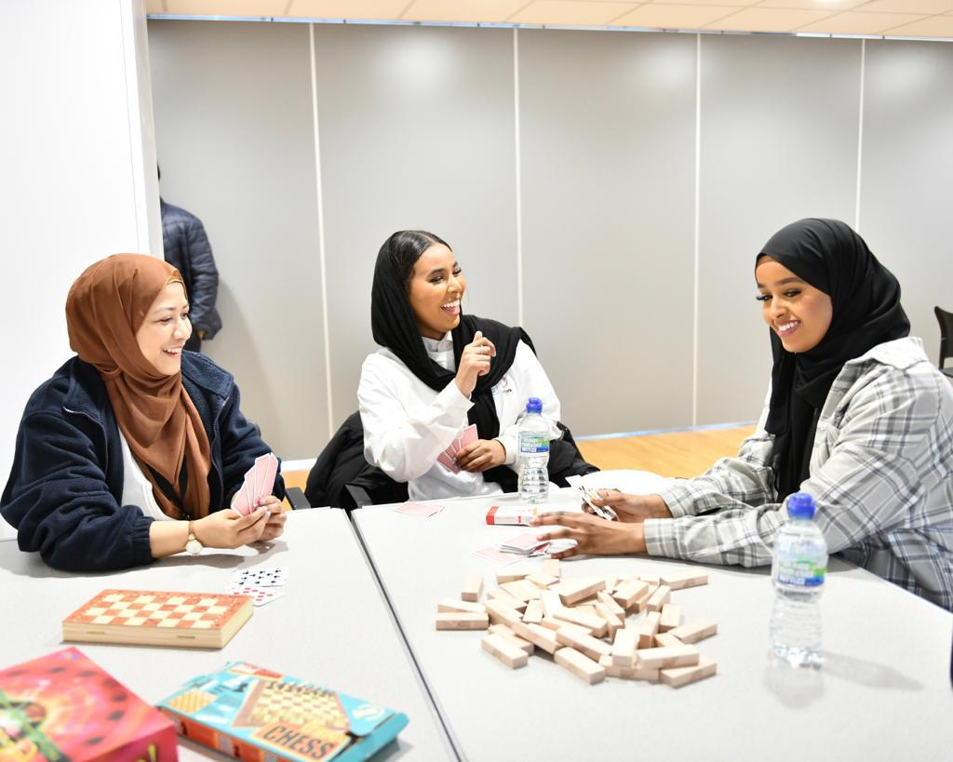
PILOT PROGRAMME: RECOMMENDATIONS
Commissioning
Consider longer mobilisation period
Establish monitoring expectations from the outset and in collaboration with providers
Consider the VRU’s role in communicating the programme with wider network
Programme design & delivery
Better co-ordination across providers
Widen communication of programme
Give attention to onward signposting
Consider graduation events for younger cohort
Regularly review content
Consider a whole-family approach
Data Systems
Consider collecting data in alignment with Theory of Change & long-term outcomes
Align outcome measurement across providers
Support the collection of data through training
Notes:
The recommendations for the evaluation of the pilot programme have directly informed the commissioning of the current Community-based mentoring programme in line with our wider strategic approach of our GYW Plan and working towards national priorities including:
the government’s mission to reduce VAWG by 50%
providing better opportunities and mental health support for young people which links to the Young Future Hub priorities
Both the delivery partners and the evaluators of the pilot were successful in the commissioning of the second programme & evaluation, which made the implementation of recommendations a smoother process.
We commissioned Ecorys and Renaisi as more of a learning partner for this iteration, helping to build capacity and connectedness of the providers, develop a ToC and working towards longer-term outcomes, improve the data collection strategy in collaboration with us and the providers, and align outcomes measurement across the providers.
The providers have implemented a stronger partnership with regular meetings and communication. They have also incorporated graduation events for the younger cohort as a way to improve the ending of support, ensuring this is a positive thing for the young people.
We are having encouraging conversations about our role in regional coordination of this work / pleased to see this government place emphasis on prevention

Slide 20
THANK YOU
Nickiesha Henry (nickiesha.henry@london.gov.uk)
Eleanor Parker (eleanor.parker@london.gov.uk)

Slide 21


Human resources slide 1
SOFEA –
SCHOOL NAVIGATORS
Restorative Life Coach Mentoring - A Journey of Growth and Success

Slide 22
Human resources slide 2
Every School Needs a School Navigators Programme:
•📉 Reduces Suspension Rates
•🧑‍🏫 Eases Teacher Workload
•🌱 Improves Overall School Dynamics

Slide 23
Human resources slide 2
Why Suspended Students?
Initial data analysis showed that around 70% of children who were suspended for the first time would go on to be suspended again in the same school year
Risk Indicator for Violence
Using Violence Already, But Not Recorded
Already Disruptive/Angry
Disrupting Their Own Education & Others’
Teacher and administrative workload impacted significantly
Reduces Future Opportunities

Slide 24
Human resources slide 2
Key Contributors to the Programme
Kelly Reed – Detective Inspector
Tori Olphin – Head of Data Science, Research & Evaluation
SOFEA Wellbeing Team – 5 Dedicated Youth Mentors
8 Schools – Milton Keynes

Slide 25
Human resources slide 2
What did we deliver?
SOFEA delivered the schools navigators program in schools
4 schools receiving treatment, 4 in control
165 referrals made following first suspension
6 sessions of mentoring
Students completed baseline and follow up self-assessed questionnaires (SDQ and WEMWBS)
Participation led, strengths and needs approach to exploring how to support a young person to make their own behaviour changes
Tracking at all stages; attended sessions, questionnaires completed, referrals received.

Slide 26
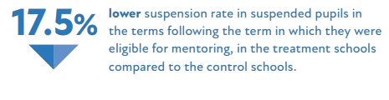
Human resources slide 2
Results:
Warwick Edinburgh Mental-Wellbeing Scale
87 WEMWBS were completed
53% response rate, so there is a risk of selection bias
Significant increase in total score, a positive metric.

Slide 27
Human resources slide 2
Strengths & Difficulties Questionnaire
63 Strengths & Difficulties Questionnaires were completed
38% response rate, so there is a risk of selection bias
The results showed significant reduction in:
total difficulties reported
total hyperactivity reported
total supplement score
total externalising score
prosocial score
Non-significant reductions in internalising, emotional problems, conduct problems and peer problems measured

Slide 28
Qualitative feedback from teachers
“There are some who still have showed a few silly low-level behaviours, however, these behaviours are not as consistent as they used to be or as challenging/aggressive. The students can regulate their emotions better, more safely and will listen to staff better than before.” - Hazeley Academy
“The SOFEA mentoring programme has made a huge impact to our students. The students enjoy the sessions, they use the strategies given by the mentors to help manage their difficulties during the school day.
The students have had fewer suspensions since starting the programme and they’re more engaged and focused during their lessons.” - Lord Grey Academy

Slide 29
Qualitative feedback from students
"I learnt to like myself and to be at peace with that. To focus on the good stuff and not on the bad stuff."
“I can handle situations better, I either leave or walk away instead of shouting, screaming and swearing. I take away from the sessions that I am a bit more confident at talking to people that I don't know.”
"I'm calmer, you taught me to calm down in stressful situations. I have been able to make new friends, before I only had 2-3 friends, and now I have 15. People want to be around me more because I am not so angry."
“These sessions have been sick, they helped me set some goals I want to get to and also think about respecting my family more. I have made my relationship with my mum and my nan better.”
“It’s been better as normally I don’t have anyone to speak to. I haven’t got as angry and haven’t got angry in school. I focus better and I can now understand what the teachers are saying and I can see it from their point of view.”

Slide 30
Human resources slide 2
Every School Needs a School Navigators Programme:
•📉 Reduces Suspension Rates
•🧑‍🏫 Eases Teacher Workload
•🌱 Improves Overall School Dynamics
What We Need From You:
Advocate for a School Navigators Programme in Every School
Provide Funding and Resources
Create a Network of Support for the students

Slide 31


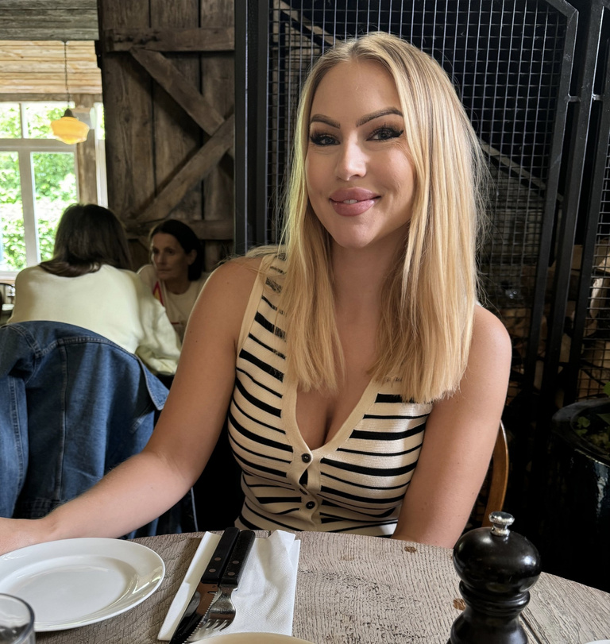
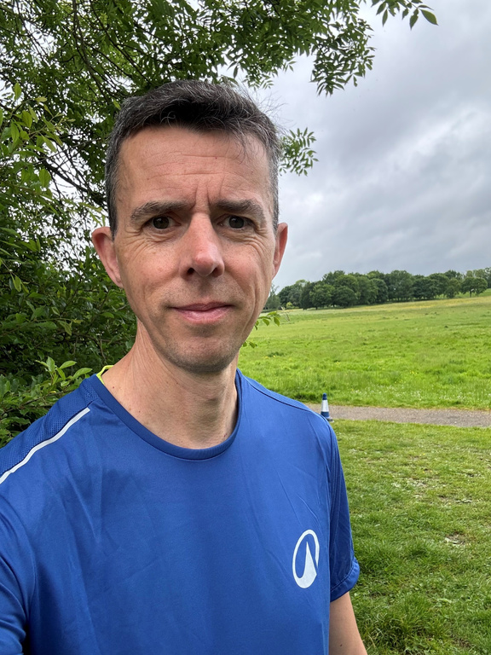
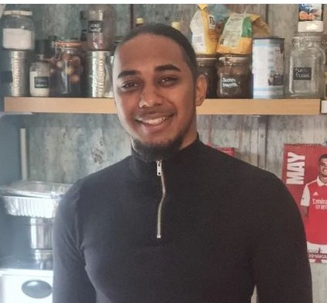

Our Wellbeing Team
Arshna
Steph
Head of Wellbeing & DSL
Paul
Wellbeing Coach
Site Director & Life Coach Mentor
THANK YOU!
Please email for further questions:
Arshna@sofea.uk.com
Simon
Rae
Life Coach Mentor
Life Coach Mentor

