Slide 1


Preventing Youth Violence:
Research & Evidence Conference 2025
Talking Therapies Panel

Slide 2




Your Choice
&
London Young People Study
Dr Karla Goodman, Director of Practice, LIIA
Dr Tom Davies, Head of Research, Evaluation & Learning London’s VRU

Slide 3


Children and young people most affected by violence are the ones who most need therapeutic support but are currently the least likely to get it.
This is what Your Choice aims to change.

Slide 4
The Your Choice framework
A new framework developed for local authorities, which supports their youth practitioners to deliver CBT tools and techniques to their most vulnerable young people.
This framework is rooted in:
Multi-agency working practices (e.g. referral routes).
Current best practice in adolescent safeguarding, using a public health approach
Response to current presentation, not a requirement to wait until fit criteria
Upskilling practitioners & young people alike; to take young people on journey of “guided discovery” and equip them with tools and techniques that can be useful in overcoming a range of psychological challenges
Range of psychological theory including developmental, trauma and neurological theory and best practice in relation to adolescent safeguarding.

Slide 5
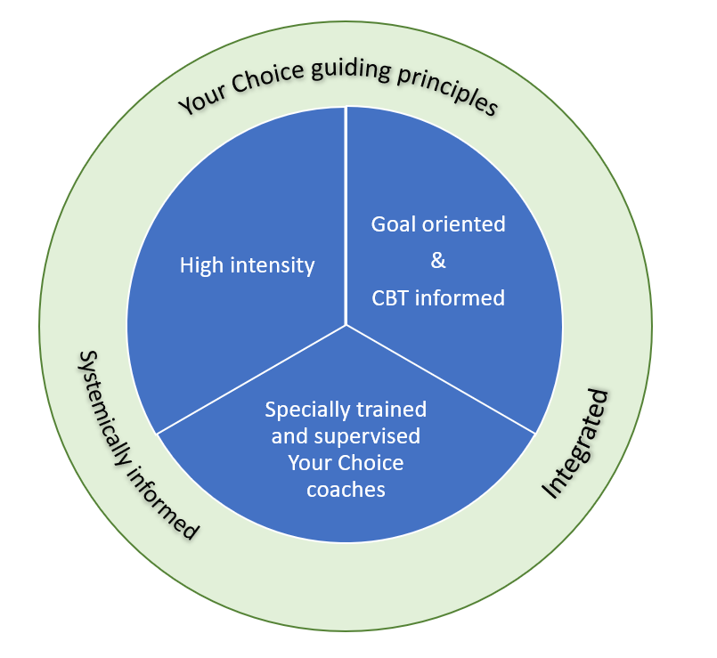

Core components

Slide 6

What is the London Young People Study?
A London wide “gold standard” research trial (The London Young People Study- Randomised Control Trial LYPS- RCT) is currently underway, which will help to determine the impact of the new Your Choice programme.
This is the largest study of it’s kind with this cohort in England.
LYPS follows a successful pilot trial between April 22 & March 2023, where local authorities were able to appropriately apply the evaluation methodology and highlight the promise of the programme.
Currently 1,403 young people, across 31 Local Authorities, from 120 Adolescent Safeguarding teams, assessed as medium to high risk of contextual harm recruited into the study.
Your Choice
Business as usual

Slide 7
Your Choice in London- emerging impact
Pilot Study evidenced ‘promising programme’, midway through Efficacy Trial
Qualitative evidence
Young people indicated improvements in mental health
Feeling happier, more positive and purposeful.
London feedback
System savings – reduction in placements and missing episodes
Improved child outcomes - increased school attendance, better engagement, improved relationships in the home and ETE settings.
Improved resilience and “stickability” in workforce and young people.
Purposeful relationships enabled through the use of CBT tools and techniques
Improved practitioner job satisfaction and retention.

Slide 8
Looking forward – next steps for Your Choice
Opening door for implementation in new environments
  Greenwich Schools Trial / VRU Inclusion Charter
  Youth First Lewisham
Leading learning, best practice and capacity building to ensure sustainability of approach across London
Learning & collaboration to inform design and implementation of national progs -
Young Futures / Prevention Partnerships

Slide 9

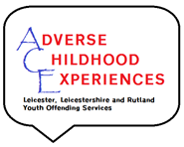

Adverse Childhood Experiences (ACES)
Alex Levy Donna Stafford Georgia Emery
Forensic Psychologist RMN RMN
Notes:
9

Slide 10
Child & Young People’s Mental Health Transformation Programme (2018/2019)
CYP who are at risk of receiving services delivered via NHS England Health & Justice commissioned provision (secure settings
CYP returning to the community from secure settings
Service offer
MBT informed service (lack of EBP for vulnerability to health and criminality)
Herman’s Three stage model (Engagment, specialist intervention, reintegration)
Service Offer
Stakeholder engagement on YOS panels (high risk, Education, other specialist forums for children who are at risk
Teaching and training (basic training in child and youth topics, TIC/TIP, mental health workshops)
Consultation (about individual young people)
Formulation (for those identified as complex)
One to one work (4+ or 3++)
Notes:
10

Slide 11
Observations:
Systemic issues
Services designed for quick turn over and target driven engagement (- safety and relationship building, engagment, trust,)
Engagment YP’s & Parents (social media, WhatsApp’s)
Focus on age 18 rather than more modern understandings of maturity (24+) (Neuroscience, trauma, behavioural outcomes)
Community provision (buildings, youth centres, safe and accessible spaces, activities, homes, transportation)
Funding mostly at young people rather than early Intervention (5+)
Family issues
Transgenerational trauma
Fear and suspicion of services and authorities, significant experience of failure)
Wider social problem (lack of engagment with traditional mail, Social media, transportation)
Large family with multiple children with significant social emotional and mental health needs, fix them)
Personal issues
Hopelessness
Significant isolation (physically, socially, behaviourally)
Experiences of support services and workers that have failed to create any sense of change
Notes:
11

Slide 12



Slide 13

Who are Base 51?
Base 51 are a Nottingham-based charity, dedicated to supporting young people between the age of 11-25 years old.
We offer counselling, group work, youth work and much more.
We offer an holistic approach to young people’s mental and physical health, providing them with any support they may need
We have been supporting young people for 30 years by offering a safe place where change can begin.

Slide 14


Evolution Plus – The service
Specialist trauma service for anyone aged 11-24, who has been affected by serious violence, across Nottingham City or County.
This could be as a : Witness, Victim, Perpetrator
Types of violence can include:
  domestic abuse
  sexual violence
  knife crime
  gang-related violence.
Client Journey:
1. Initial assessment – HEADSS assessment (Cohen et al. 1991)
Home, Education, Activities, Drugs use and abuse, Sexual Behaviour, Suicidality and Self-harm
2. Up to 6 sessions of therapeutic intervention
CBT-style intervention/ Self-care planning/ Safety planning/ Wellbeing support
3. Up to 20 sessions of trauma therapy
4. Final assessment
Outcome Measures – CPSS (Foa et al. 2001), YPCORE (Twigg et al. 2010)
Further support options
Cohen, E., Mackenzie, R. G., & Yates, G. L. (1991). HEADSS, a psychosocial risk assessment instrument: implications for designing effective intervention programs for runaway youth. Journal of Adolescent Health, 12(7), 539-544. Foa, E. B., Johnson, K. M., Feeny, N. C., & Treadwell, K. R. H. (2001). The Child PTSD Symptom Scale: A preliminary examination of its psychometric properties. Journal of Clinical Child Psychology, 30(3), 376-384 Twigg, E., Barkham, M., Bewick, B. M., Mulhern, B., Connell, J., & Cooper, M. (2010). The Young Person’s CORE: Development of a brief outcome measure for young people. Counselling and Psychotherapy Research: Linking Research with Practice, 9, 160 – 168. http://doi.org/10.1080/14733140902979722

Slide 15
Evolution Plus - Rationale
Understanding Trauma therapy:
The Fight, Flight, Freeze response (Cannon, 1929)
Trauma therapy with Evolution Plus:
Humanistic, person-centred (Rogers, 1942)
  Emphasis on the client moving at their own pace and the therapist responding to what is presented to them by the client, rather than focussing on analysis
    promotes control and creates a safe space for the client (Joseph, 2004; Rutherford, 2011)
Focussed on post-traumatic growth (Tedeschi and Calhoun, 2004)
Impacts of serious violence
Physical – injuries, chronic ill health
Psychological wellbeing – mental ill health, low self-esteem, difficulty coping with stress.
Social – difficulty trusting others, forming unhealthy relationships
Behavioural – engaging in risky behaviours, aggression
(Holt et al. 2008; Hillis et al. 2016)
Cannon WB: Bodily Changes in Pain, Hunger, Fear and Rage: An Account of Recent Research Into the Function of Emotional Excitement, 2nd ed. New York, Appleton-Century-Crofts, 1929. Hillis, S. D., Mercy, J. A., & Saul, J. R. (2017). The enduring impact of violence against children. Psychology, Health & Medicine, 22(4), 393-405. Holt, S., Buckley, H., & Whelan, S. (2008). The impact of exposure to domestic violence on children and young people: A review of the literature. Child abuse & neglect, 32(8), 797-810.. Joseph, S. (2004). Client‐centred therapy, post‐traumatic stress disorder and post‐traumatic growth: Theoretical perspectives and practical implications. Psychology and Psychotherapy: Theory, Research and Practice, 77(1), 101-119. Rutherford, M. C. (2007). Bearing Witness: Working with clients who have experienced trauma—Considerations for a person-centered approach to counseling/Zeuge sein: Die Arbeit mit traumatisierten Klientinnen und Klienten. Überlegungen zu einem Personzentrierten Ansatz zur Beratung/Ser testigo: Rabajar con consultantes que han vivenciado trauma. Consideraciones para un enfoque centrado en la persona/Témoignage: Le travail avec des clients ayant vécu des expériences traumatiques. Réflexion sur une approche du counselling centrée .... Person-Centered & Experiential Psychotherapies, 6(3), 153-168. Rogers, C. R. (1942). Counseling and psychotherapy; newer concepts in practice. Houghton Mifflin. Tedeschi, R. G., & Calhoun, L. (2004). Posttraumatic growth: A new perspective on psychotraumatology. Psychiatric times, 21(4), 58-60.

Slide 16
Evolution Plus - Outcomes
Evolution plus supported received over 125 new referrals in 23/24, 55 young people had up to 20 sessions of trauma therapy and/or up to 6 sessions of CBT style intervention, signposting and psychoeducation​
Client A:
Referred after experience of sexual violence.
Presenting with isolation, difficult family relationships, anxiety, anger, self-esteem issues, impacted university studies and career plan.
Client B:
Referred after experiencing two violent physical assaults/ domestic violence/bereavement/ an emotionally abusive relationship.
Presenting with depressive episodes, self-harm, anxiety and avoidance behaviours, disengaged from education.
Key findings from the service:
Clients present with an integration of different experiences that tend to exacerbate each other.
A client must feel ready to begin therapy and address their trauma.
Therapeutic intervention can support with stabilisation before therapy.
Clients value having the space to openly speak about their experience without judgement.

