Slide 1


Preventing Youth Violence:
Research & Evidence Conference 2025
Youth Voice and Lived Experience Inclusion in Research Methodology and Decision-making

Slide 2






Wales Without Violence: A Shared Framework for Preventing Violence among Children and Young People
Stephanie McArdle, Peer Action Collective
Dr Alex Walker, Wales Violence Prevention Unit

Slide 3
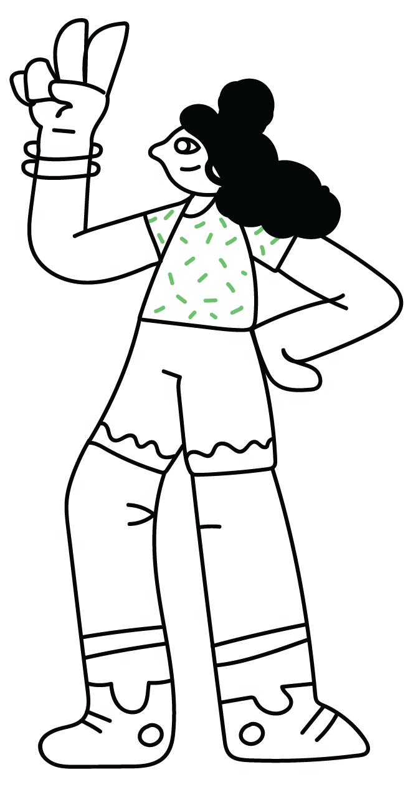
WALES WITHOUT VIOLENCE
The Framework was published in April 2023. It is co-produced by the Wales Violence Prevention Unit and Peer Action Collective Cymru.
The Framework is a guide to violence prevention which can be used by professionals to develop primary prevention and early intervention strategies to end violence among children and young people through a public health, whole-system approach.
The Framework includes nine strategies which aim to prevent violence across different age groups and in different places. Each strategy includes examples of current practice in Wales, to show how these strategies can be tailored to suit local needs.
It also includes nine violence prevention principles, identified by children, young people and professionals, that should underpin all violence prevention activity.

Slide 4



Why focus on Violence among Children and Young People?
Our co-produced definition:
1
Children and young people are most at risk of experiencing violence
2
Children and young people are most likely to experience multiple forms of interpersonal violence
3
Evidence suggests that prevention approaches are most effective when implemented with children and young people

Slide 5
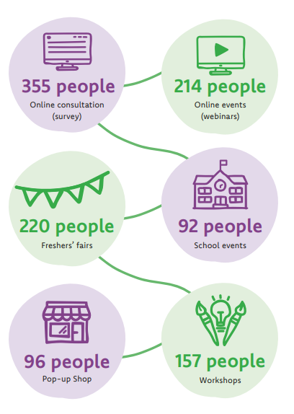


What we heard from Children
and Young People
Children and young people want to feel safe to be themselves.
The term ‘youth violence’ is vilifying and contributes to negative stereotypes
Did not understand violence in siloes professionals often use
Felt that they had the power to make change, but were not always listened to

Slide 6
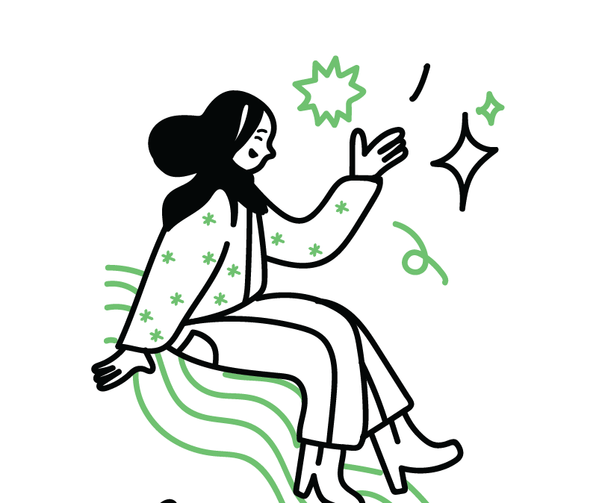
Why focus on Violence among Children and Young People?
Our co-produced definition:
“Violence among children and young people is an umbrella term for acts of, or the threat of, violence and abuse between those under the age of 25 . It can be physical, verbal, psychological, sexual or economic. It can occur in the home, education settings, workplace, community or online.”

Slide 7
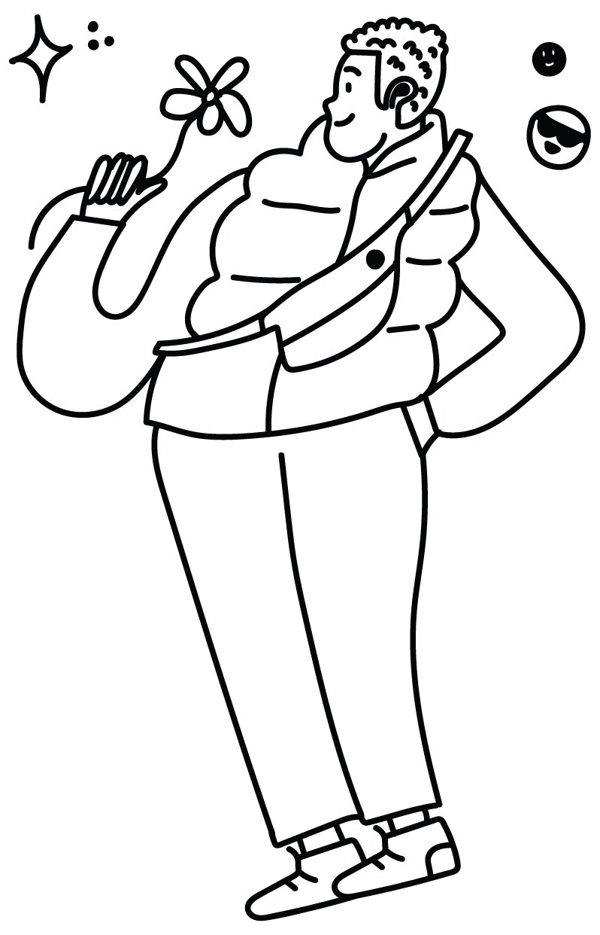

9 Principles for Violence Prevention
1
Recognise that violence is preventable
6
Use an intersectional lens
2
Build partnerships for prevention
7
Integrate multi-agency data into decision-making
3
Co-produce the solutions
8
Take an evidence-based approach
4
Uphold children’s rights
9
Be proactive in involving communities
5
Take a trauma-informed approach

Slide 8
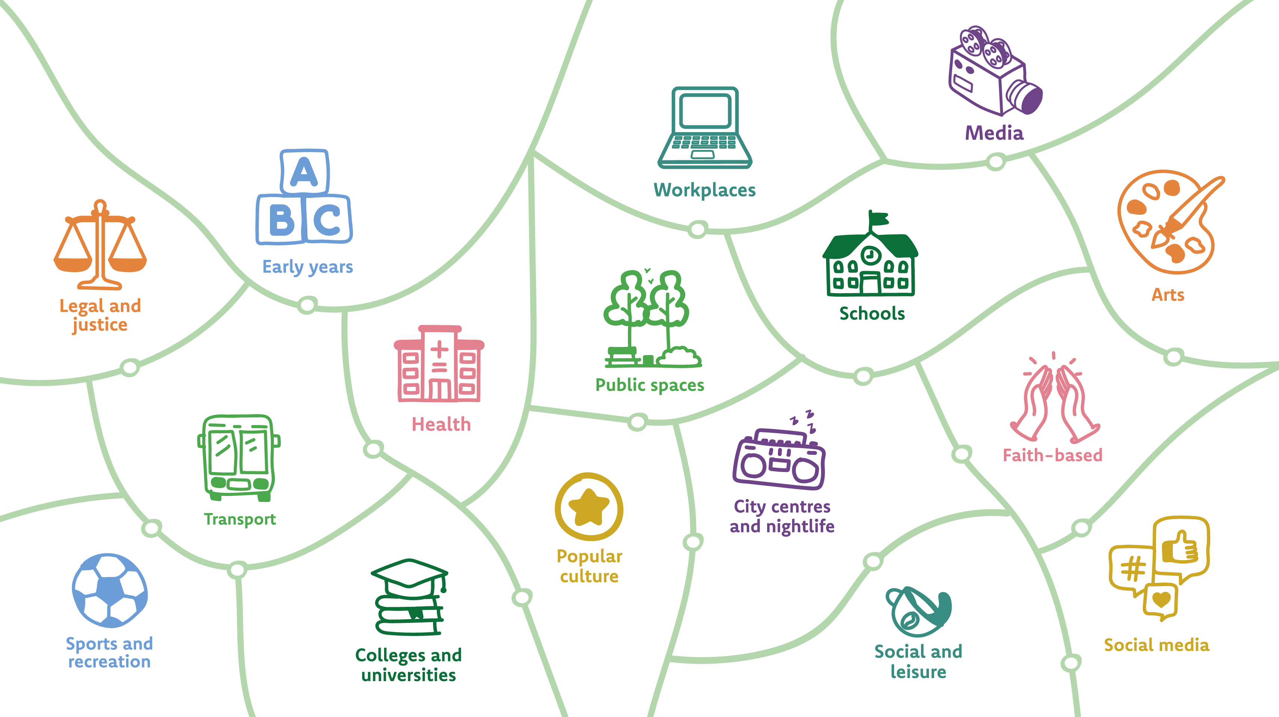
Violence Prevention Settings

Slide 9

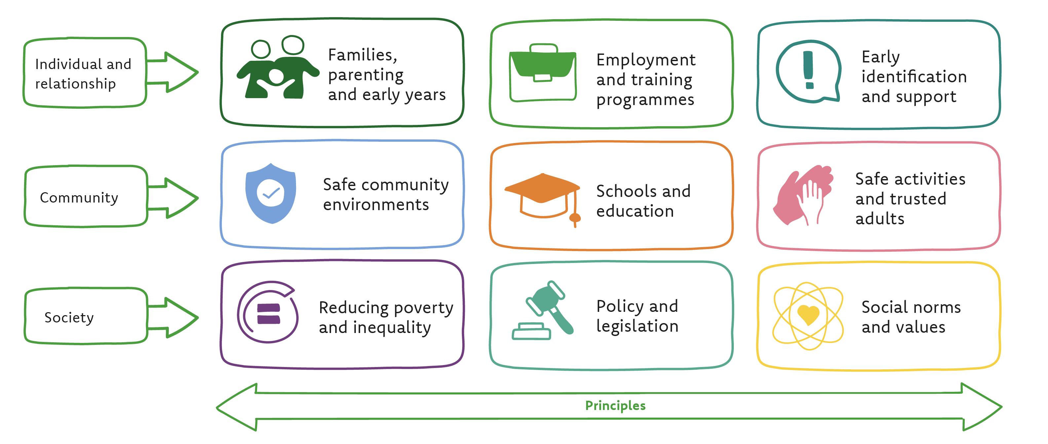
Nine strategies for Preventing Violence among Children and Young People

Slide 10

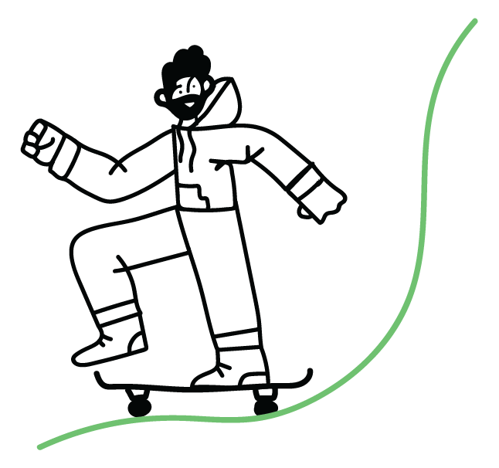
Way forward
Promoting the framework & raising awareness in context of SV Duty
Theory of change
Evaluability assessment
Stakeholder engagement and
co-production
Decisions on next steps for implementation

Slide 11
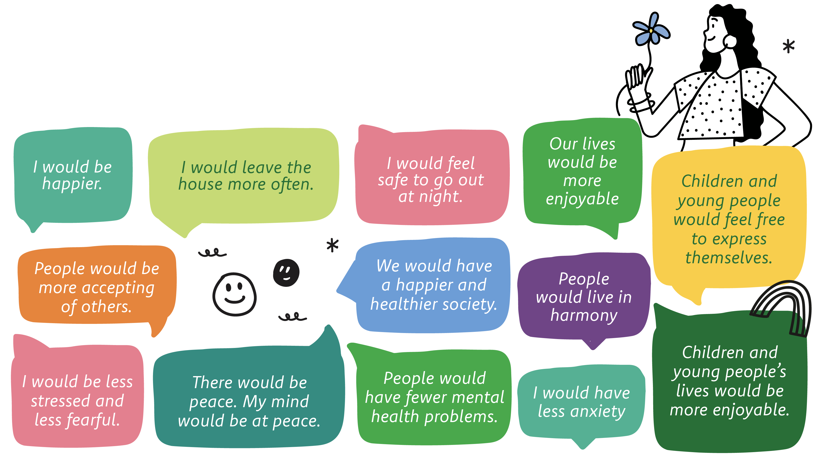
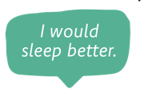


Slide 12

Diolch!
www.waleswithoutviolence.com

Slide 13
Youth voice and lived experience in research investigating the relationship between adverse childhood experiences and youth violence
Dr Paul Gray
Manchester Centre for Youth Studies

Slide 14
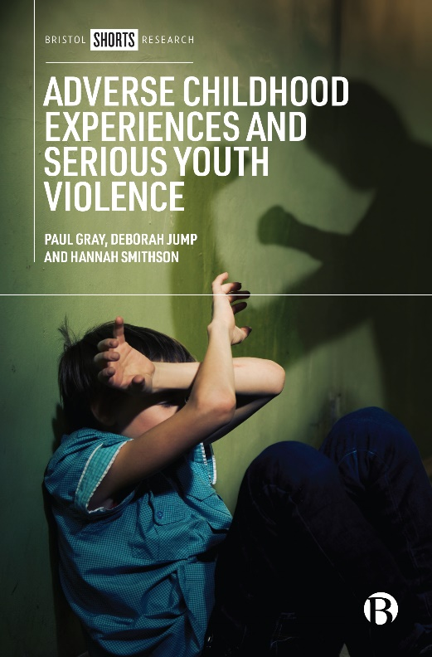
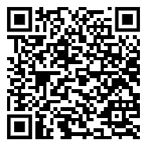
Introduction
Despite an overall reduction in crime in England and Wales, youth violence remains a concern
Perpetrators of youth violence often have significant evidence of adverse childhood experiences and childhood trauma
Lack of research with justice-involved young people that investigates the relationship between adverse childhood experiences and youth violence

Slide 15
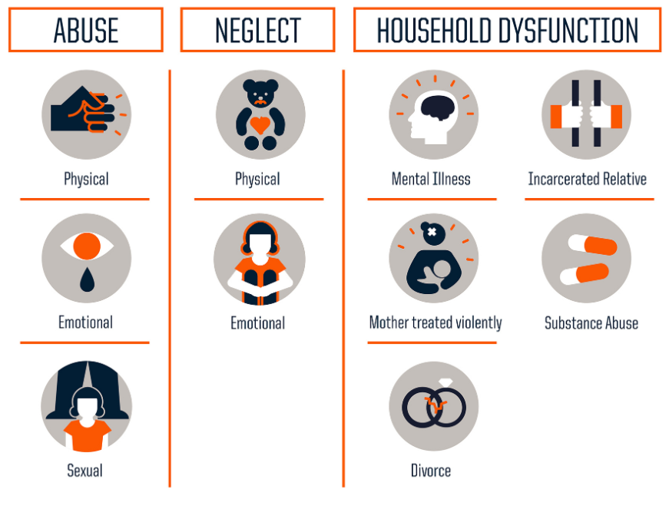
Research design
10-point ACEs assessment tool based
Semi-structured interviews with youth justice practitioners
Narrative life story interviews with justice-involved young people
Creative participatory workshops with justice-involved young people

Slide 16
Prevalence of adverse childhood experiences
Two thirds (n=132) had five or more ACEs
Over a fifth (n=43) had eight or more ACEs
Three children had all ten ACEs

Slide 17
Types of adverse childhood experiences
Three quarters (n=150) had experienced abuse
Nearly three quarters (n=142) had experienced neglect
Three fifths (n=121) had experienced abuse and neglect

Slide 18
Creative participatory workshops
Four workshops were delivered
The first two were creative participatory workshops facilitated by three dramatherapists
Due to the nature of the research (ACEs), the 6-Part Story Method (6PSM) was used
The 6PSM focusses on fictional, third person accounts and provides metaphors rather than a description of actual lived events - creates distance between the young person and the material being discussed
The stories that were created were used to elicit further discussion
In the third workshop, the findings from the two creative workshops were analysed with justice-involved young people, and the themes were identified and agreed upon
In the fourth workshop, the research team worked with an animator to produce tangible resources for youth justice practitioners (comic and animation)

Slide 19
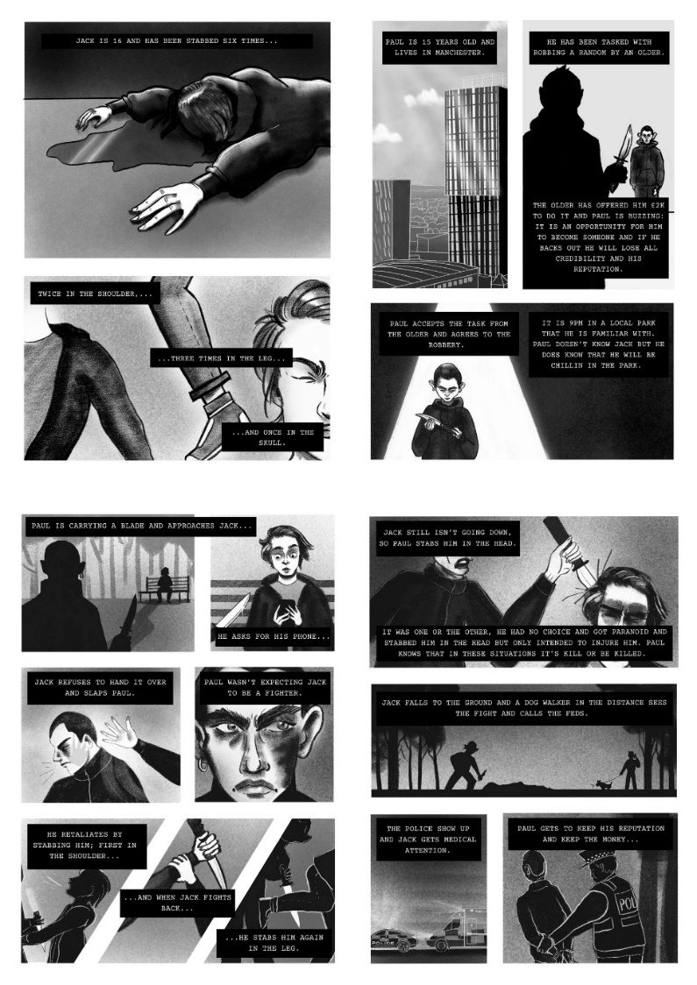
Story 1:
Jack and Paul

Slide 20
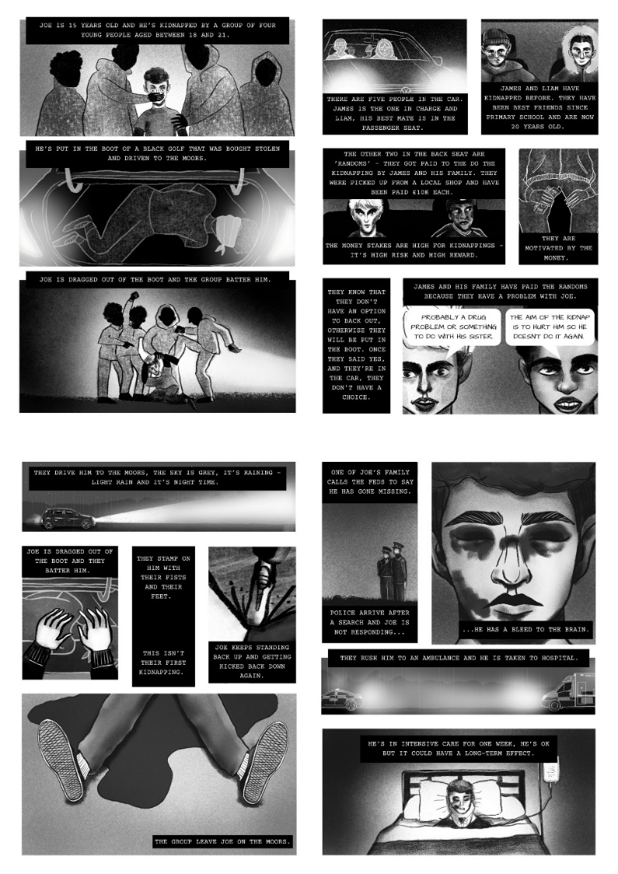
Story 2:
Joe’s kidnap

Slide 21
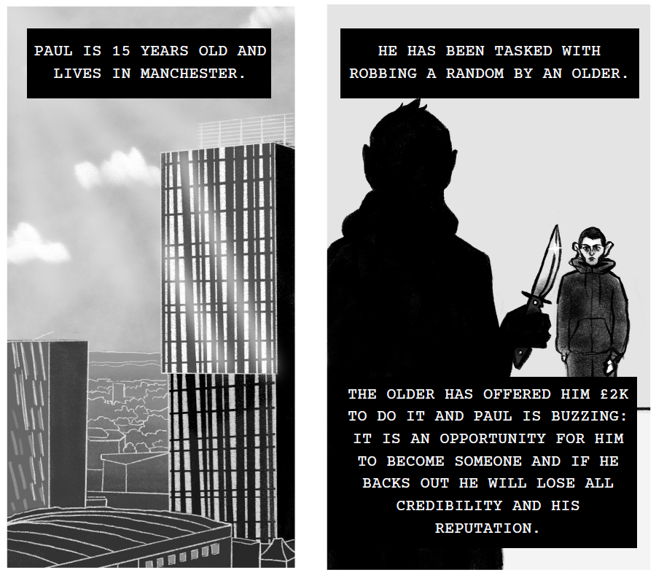
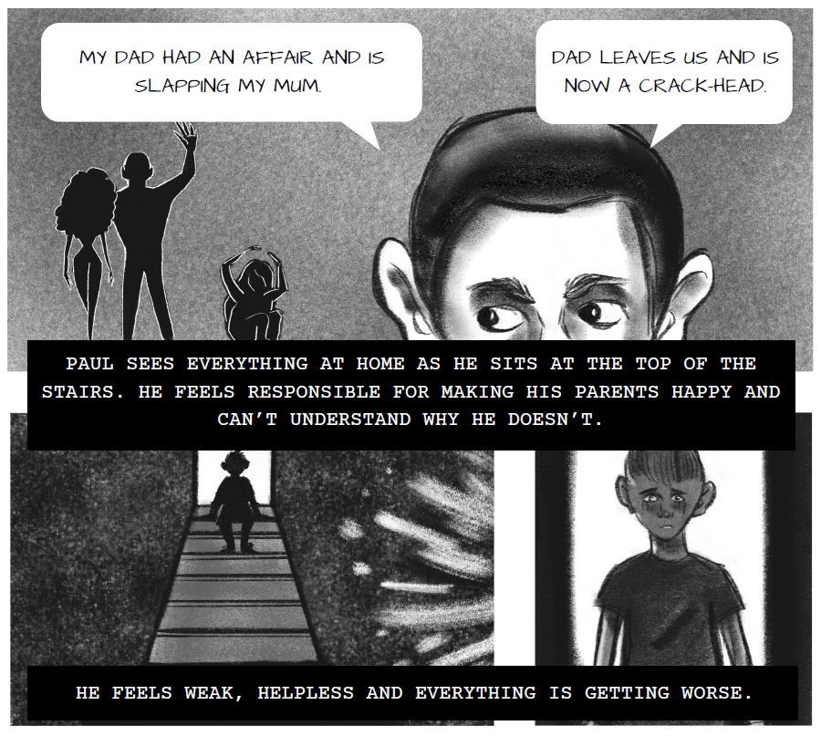

Slide 22
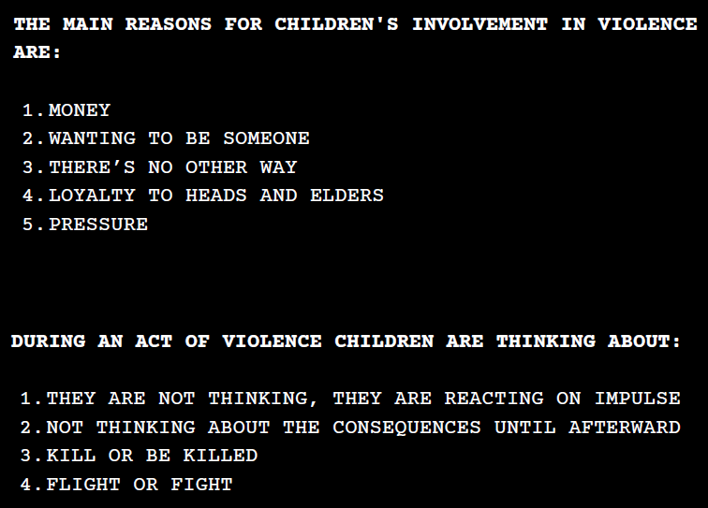
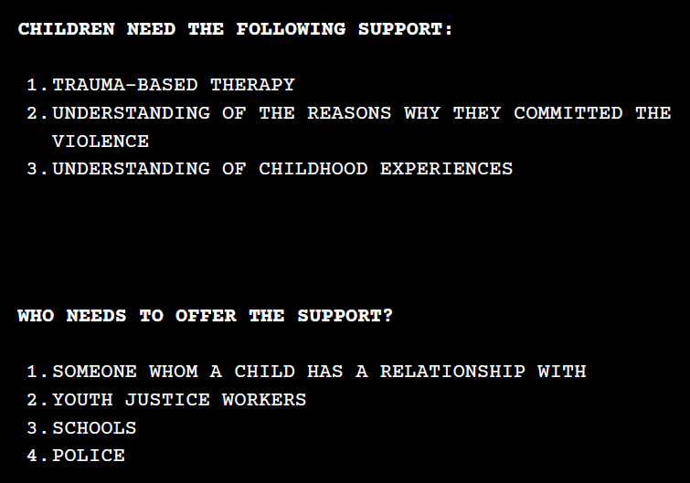

Slide 23
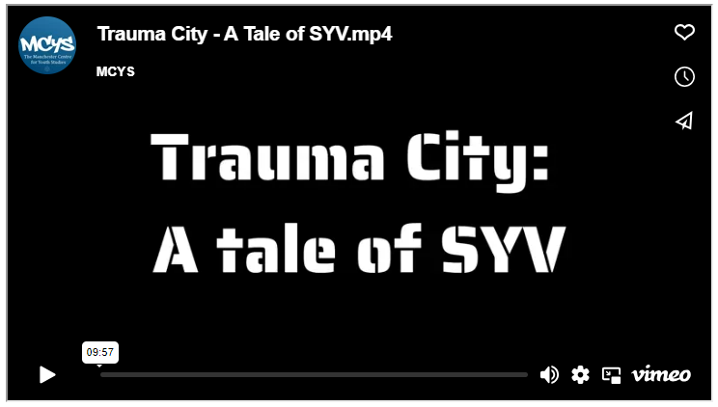
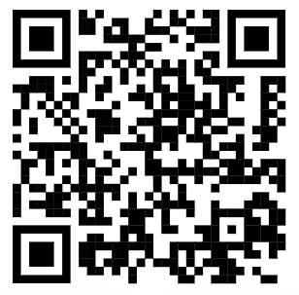

Slide 24




The Young People’s Action Group
Youth Engagement at London’s VRU
Speakers:
Zakariya Shariff, YPAG Member
Ella Burton, Research and Performance Analyst

Slide 25
YPAG overview
Group priorities
Why youth voice matters
1
  Authenticity and credibility
  Lived experience as expertise
  Empowerment
  Remuneration
  Belonging
  Co-operation
  Innovative solutions
Ensuring young people’s voice across violence reduction decision-making
2
Empowering and upskilling YPAG

Slide 26
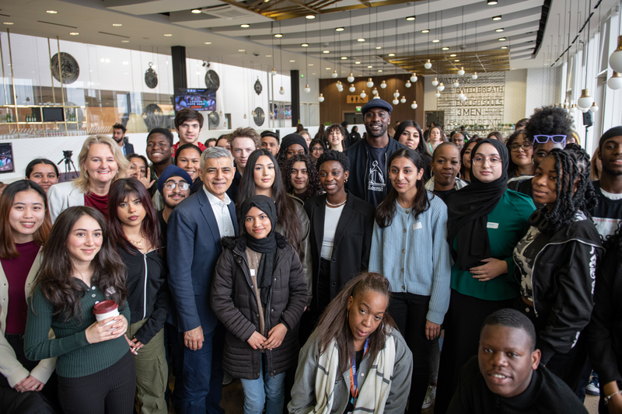

Nothing
about us without us
Notes:
Co-designed, co-led and partnership focused: by putting young people and communities at the heart of violence reduction, our funding goes beyond a traditional funder-provider relationship. We co-produce and co-evaluate programmes with our partners, ensuring that training and capacity building accompany the funding.
Yong person centred: The VRU’s approach is shaped by listening to and working with young people. Its Young People’s Action Group, formed of young people with lived experience of violence, school exclusion or experience of campaigning for the rights of young people, has exemplified good youth-led participation. Young people shape the programmes and focus of the VRU.
Community-Led - Our award-winning MyEnds programme is community-driven, and neighbourhood-focused, supporting a local consortium working on primary, secondary, and tertiary interventions. It was recently recognised as best practice by MPs Miatta Fahnbulleh and Helen Hayes, with both MPs advocating for alignment with Young Futures.
Listening to frontline insight - Our approach includes staying closely connected with practitioners and trusted adults through our Youth Practitioners Board, charities network, and schools working groups.

Slide 27
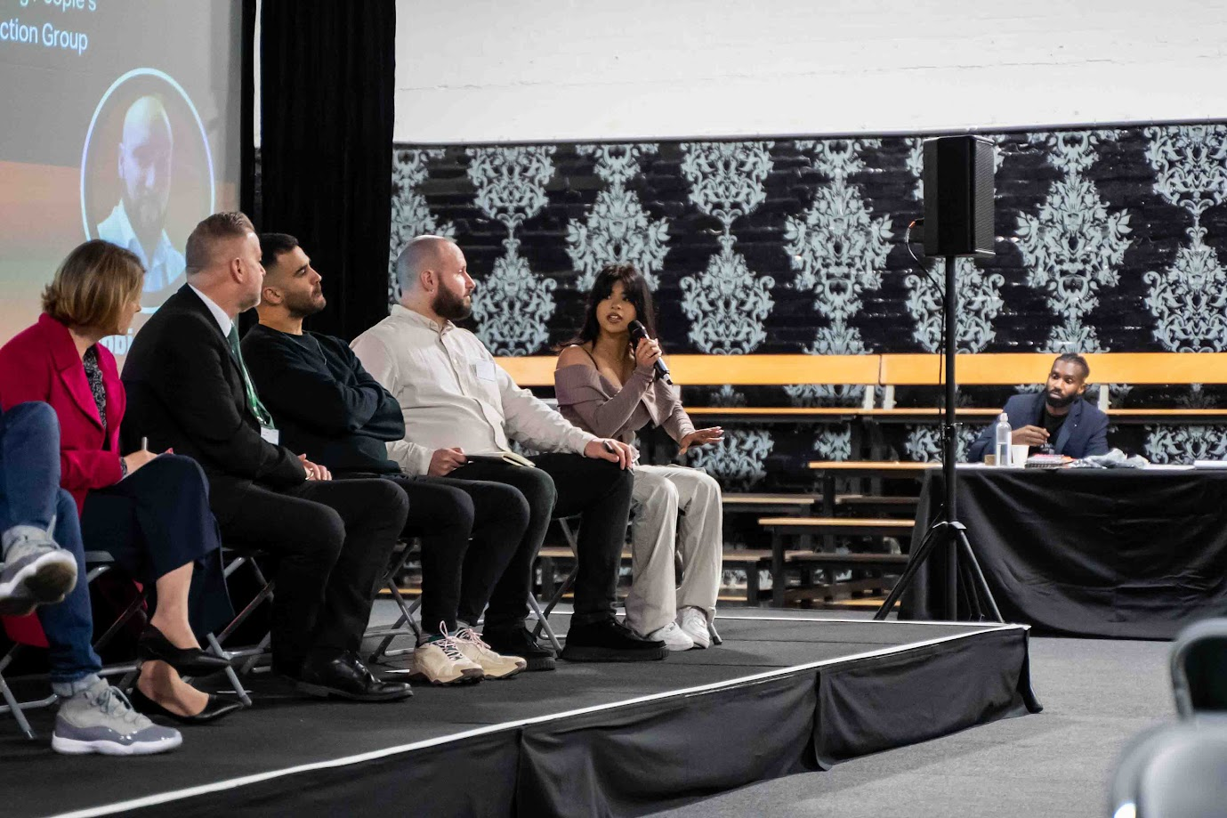
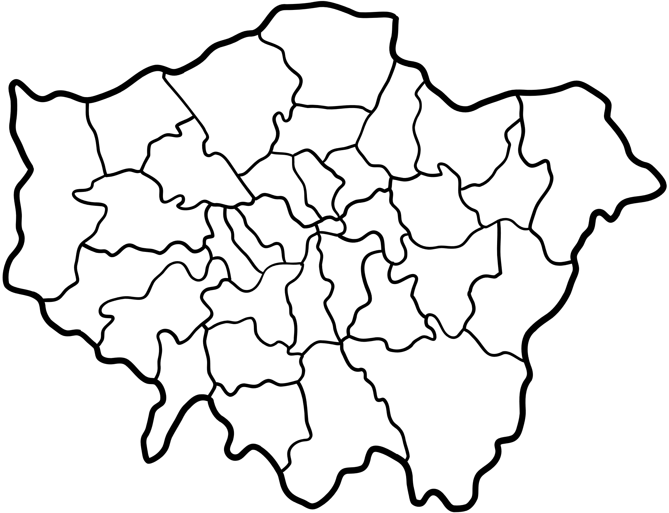
YPAG overview
Group makeup
26 young people
Gender profile:
  9 male
  17 female
Age profile:
  19 x 15-19 y/os
  7 x 19-24 y/os

Slide 28
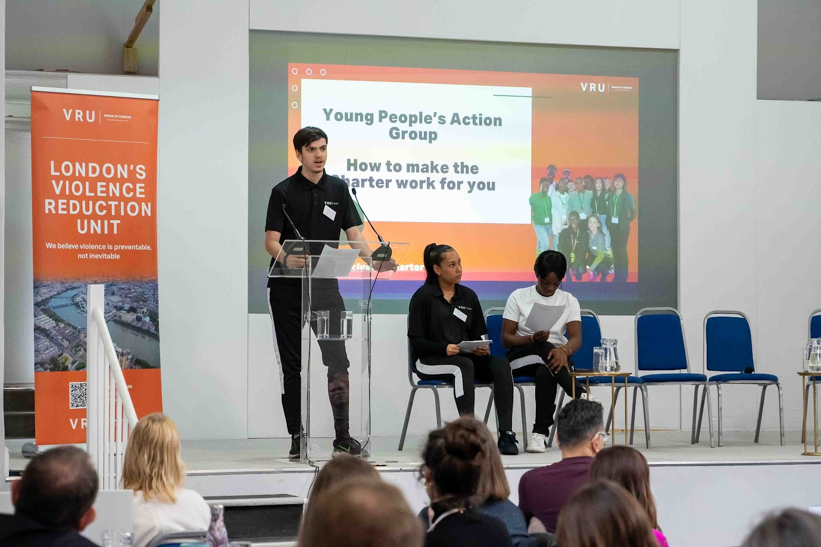
YPAG overview
Responsibilities
Programme planning
Youth voice consultations feeding into programme objectives, reach, and focus. Moderating bids.
Stakeholder engagement
Gathering insights and building relationships with stakeholders, where a youth perspective is crucial.
Research co-design
Ensuring methodologies are young-person centred and allow young people to best contribute.
Steering groups and roundtables
Lending lived experience to discussions relating to policy and practice affecting young people.
Co-delivery
Bringing young people’s perspectives and lived experience to trainings, workshops, events.
Event attendance
The VRUs youth ambassadors for key events and engagements.
Notes:
Housing consultation
Research and Evaluation Grant research methods consultation
Online Harms Steering Group
Social media roundtable
Attending the Youth Justice Board
London Sports Intervention Model research methods consultation
Trauma Informed Champions Group members and co-design
Moderation panels across VRU priority areas
Co-development of Difference Matters pilot
MyEnds evaluation peer-researchers
Speaking with students about their experience of PRU mentoring
PRU peer research project design
Resource co-production for YourChoice, inc. Checkpoint tool and ‘In conversation with’ series

Slide 29

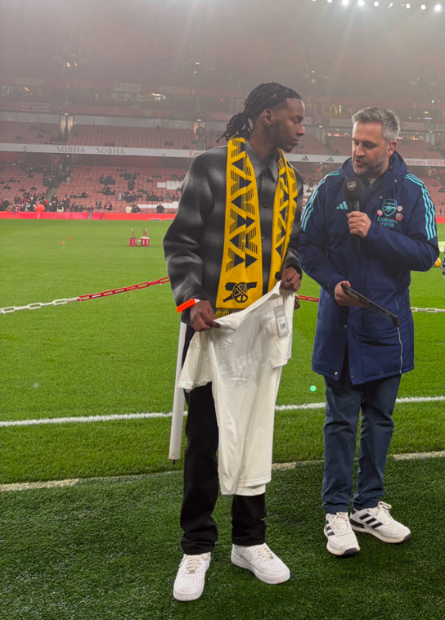
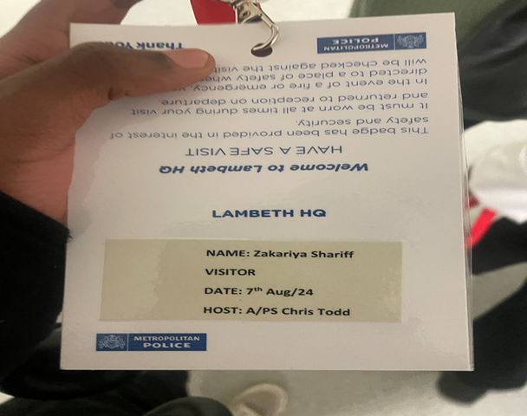
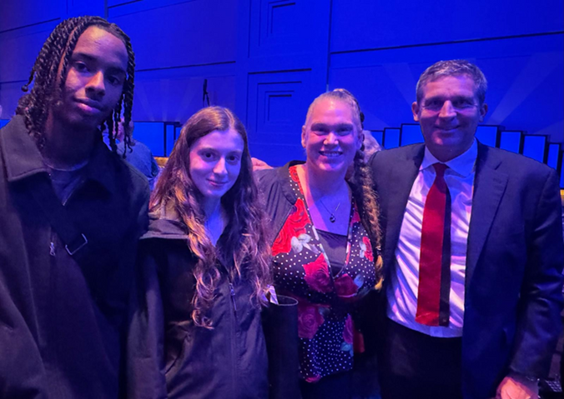
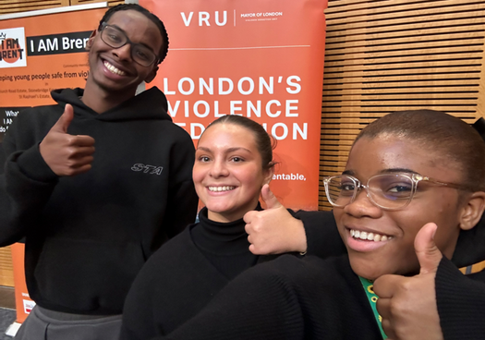
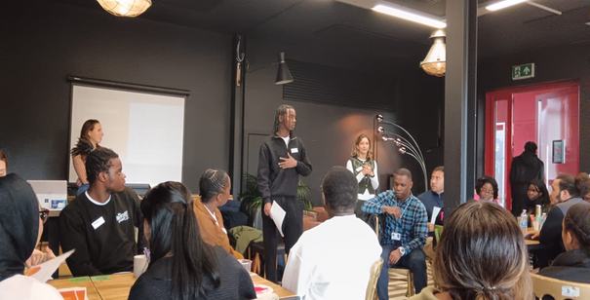
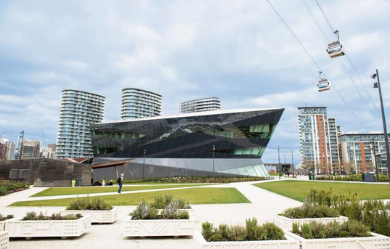
My time in the YPAG
Arsenal’s ‘No More Red’ Award
Online knife imagery roundtable discussions
Attending BBC Reith Lectures
MyEnds Winter Learning Day
Co-hosting VRU’s Social Media Hackathon
Member of VRU’s social media steering group

Slide 30
Evaluating the YPAG
Evaluate the process of implementing the YPAG model of youth participation
Jun 24 Project starts
Aug-Dec 24 Youth engagement
To explore the outcomes and impact of the YPAG model, across three areas:
  The young people involved
  The VRU’s work and decision-making
  Wider stakeholders and sectors to understand how YPAG has contributed to the violence reduction agenda
Jan 25 Parent and staff engagement
Apr 25 Interim report
Aug-Dec 25 Endline data collection
Ensuring a legacy of shared learning and evidence best practice
Apr 26 Final report

Slide 31
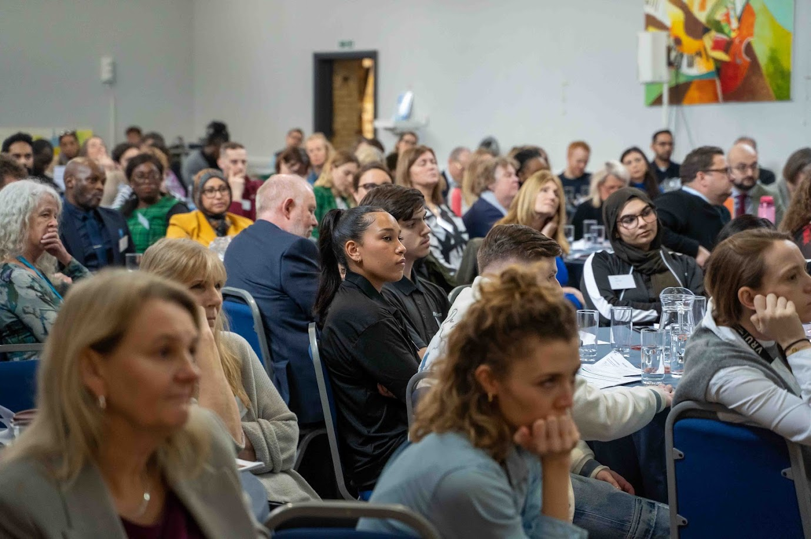
Looking ahead...
Notes:
Co-designed, co-led and partnership focused: by putting young people and communities at the heart of violence reduction, our funding goes beyond a traditional funder-provider relationship. We co-produce and co-evaluate programmes with our partners, ensuring that training and capacity building accompany the funding.
Yong person centred: The VRU’s approach is shaped by listening to and working with young people. Its Young People’s Action Group, formed of young people with lived experience of violence, school exclusion or experience of campaigning for the rights of young people, has exemplified good youth-led participation. Young people shape the programmes and focus of the VRU.
Community-Led - Our award-winning MyEnds programme is community-driven, and neighbourhood-focused, supporting a local consortium working on primary, secondary, and tertiary interventions. It was recently recognised as best practice by MPs Miatta Fahnbulleh and Helen Hayes, with both MPs advocating for alignment with Young Futures.
Listening to frontline insight - Our approach includes staying closely connected with practitioners and trusted adults through our Youth Practitioners Board, charities network, and schools working groups.

Slide 32
Children’s Voices & Lived Experience in Decision Making
Georgia Watkinson
Research & Evaluation Specialist
West Yorkshire Violence Reduction Partnership

Slide 33
Child First
“Professionals should know my story so I don’t have to repeat my story”
The West Yorkshire VRP are committed to embedding a Child First approach into everything we do
The aim of Child First is to create a system that treats children as children, builds their prosocial identity, promotes meaningful collaboration and diverts them from stigma (Youth Justice Board, 2020)
We believe that implementing this approach across our partnership will better equip us to understand and respond to children’s unmet needs
Collaboration is key to Child First so it was essential that children were able to shape what Child First looked like to them in practice
“Don’t make assumptions, get to know me”
“Listening to the boundaries I have set, and building trust with honesty and kindness”

Slide 34
Co-producing a Framework
“Explain why and say this is what we can do, what other ideas do you have”
Our framework has been co-produced with over 450 children from across West Yorkshire. This was all done through face-to-face workshops in a variety of locations including schools, alternative provisions, youth clubs and football pitches​
We used a variety of engagement methods throughout these sessions including;​
  Focus groups, some of which were child led​
  1:1 sessions​
  Drawing​
  Mind maps​
  Snakes and ladders​
After engagement we had collected over 16,000 words of feedback to analyse and my team conducted a thematic analysis on this and created a draft of the framework​
We sent this back out to every group of children we worked with to make sure we had interpreted their views correctly and got them to pick which quotes they wanted us to use throughout the framework​
This process was invaluable to us and both the team an myself learnt so much from every single child we were able to speak to
“Kids have good opinions and solutions but adults don’t listen”
“accepting sometimes we know more than professionals”

Slide 35
The Framework
“There’s a lack of positive activities for older young people or they are too expensive”
Our framework aims to outline how Child First can be incorporated at every level of an organisation​
It is split into 5 sections, each covering a separate theme that was highlighted in our engagement. This includes:​
  The importance of allowing children to help shape strategic direction,​
  Creating a culture of meaningful engagement with children, ​
  Closing the feedback loop and, ​
  Steps to make engagement with children successful​
We know that how Child First is applied will vary between roles and individual circumstances so we didn’t want to create a rigid document that wouldn’t work for everyone​
Instead, each section is summarised with key learnings from children, and includes questions we can consider to help rethink our approaches or remind of us good opportunities to involve children
“More roles like Young Advisors and roles for young people in schools would be a good idea”
“Listening and putting answers together to improve things”

Slide 36
Children informing VRP work
“Not think that cos I’ve been in trouble I’m no good”
More creative ways to feed into our work
Creative research methods
Framing our Futures launch event
“Don’t judge me cos I’m from Beeston”
Influence over comms campaigns
Youth Commission co-producing a comms campaign on their priorities
“Don’t say I’m like my brother”
Influencing decision making across West Yorkshire
Framework is now incorporated into wider policy areas e.g. policing and transport

Slide 37
“Don’t be boring!”
How are children affected by your work?
How are you listening to the voices of children?
How do you ensure children’s involvement is meaningful?
How do you feed back to children on the impact of their involvement?
Do you have child friendly versions of front facing documents?
Is the voice of the child reflected in your policies and consultations?
“They can’t grasp what you are saying so it puts you off”
“Listen – that’s most important”

